Slide 1
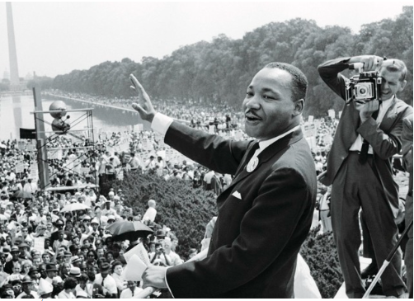
“I Have a Dream”
I have a dream that one day this nation will rise up and live out the true meaning of its creed⁽¹⁾: “We hold these truths to be self-evident, that all men are created equal.”⁽²⁾
I have a dream that one day on the red hills of Georgia, the sons of former slaves⁽³⁾ and the sons of former slave owners will be able to sit down together at the table of brotherhood.
I have a dream that my four little children will one day live in a nation where they will not be judged by the color of their skin but by the content of their character. […]
I have a dream that one day […] right there in Alabama little black boys and black girls will be able to join hands with little white boys and white girls as sisters and brothers.
I have a dream today!
Martin Luther King Jr.'s speech, August 28th 1963
In August 1963, the Civil Rights March in Washington D.C. gathered more than 250,000 people claiming for jobs, freedom and equality.

