Slide 1



Essential Tips for Proper Air Conditioning Installation

Slide 2



About Us
A new air conditioner can deliver great comfort, more power savings, and excellent features. But if your air conditioning system is not installed perfectly, it will not perform as well as it should. When the summer walkouts, you won’t want to worry about your air conditioners' performance. Air conditioning installation in Sacramento will install your new air conditioning system. It is crucial to ensure your cooling system operates efficiently and effectively. Here are some essential tips to follow when installing an air conditioner:

Slide 3
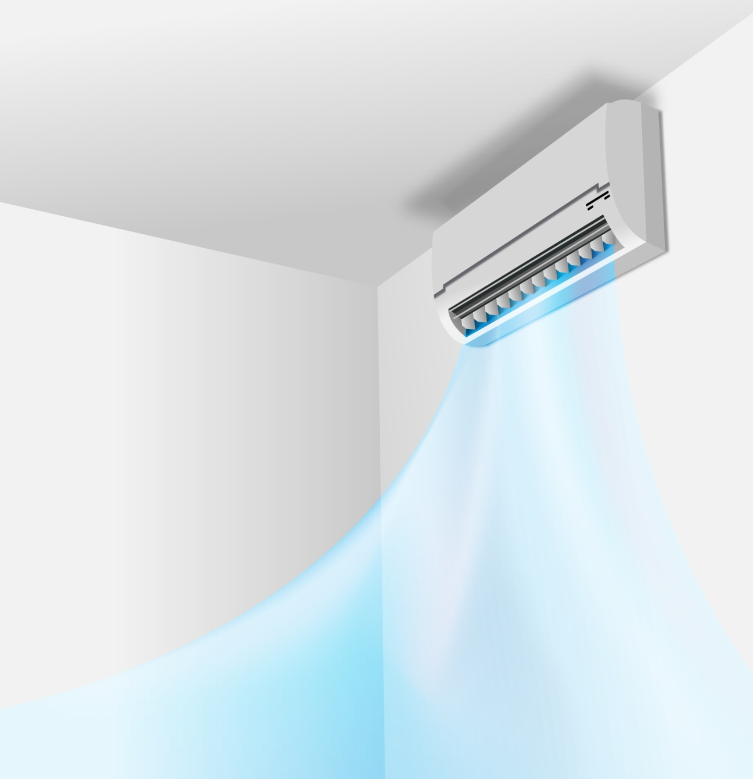
Tips for Proper Air Conditioner Installation
  Choose the Right Location:
Select a suitable place for the indoor and outdoor units. The indoor unit should be installed in a main area to ensure even cooling throughout the room. The outdoor unit should be placed in a well-ventilated area away from direct sunlight and sources of heat.

Slide 4
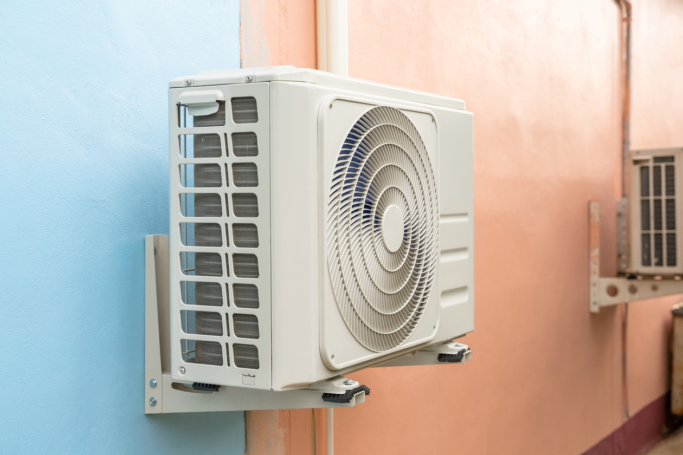
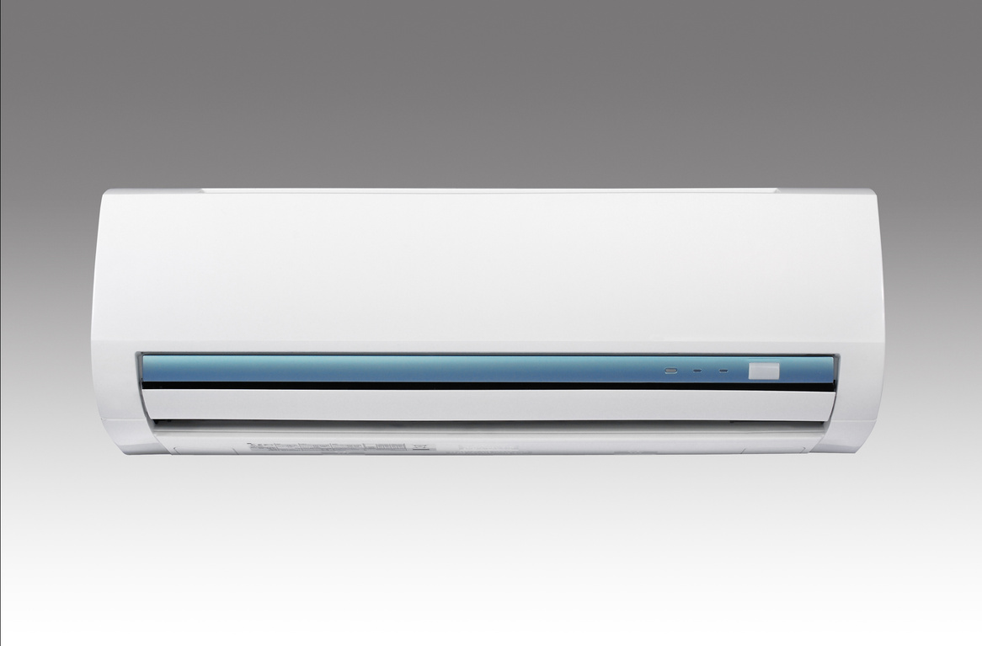
  Size Values:
Ensure that the AC unit is the right dimensions for the area you want to cool. An oversized or undersized unit can lead to inefficient operation and higher power bills. Consult an HVAC specialist to complete a load analysis to determine the proper size.

Slide 5
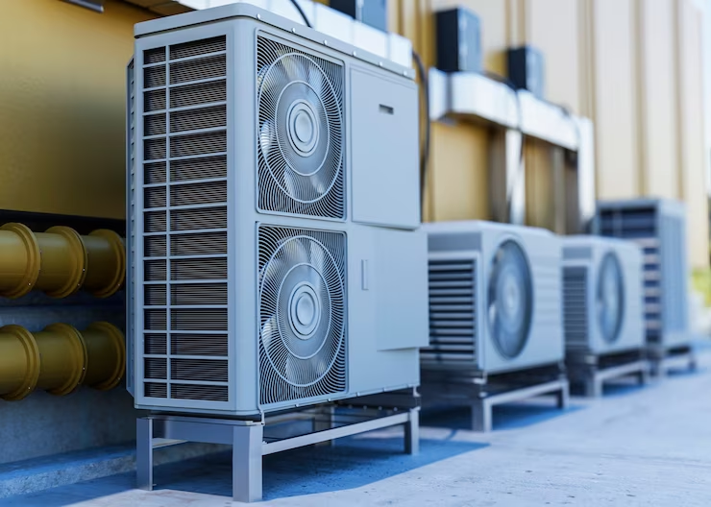
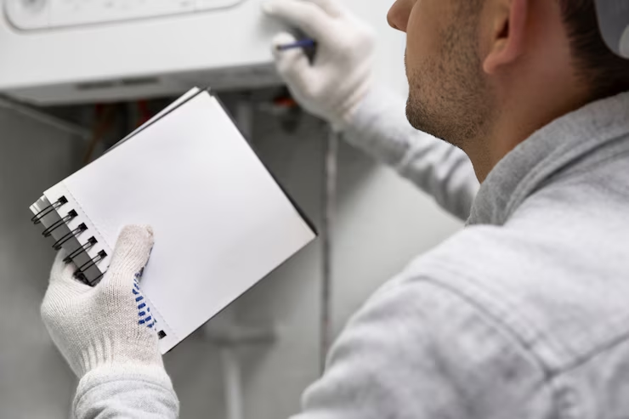
  Proper Insulation:
Insulate your home virtually to prevent the loss of cool air. Proper insulation will help maintain a constant temperature, decreasing the workload on your air conditioner.
  Follow the Manufacturer's
Instructions:
Read and follow the manufacturer's installation guidelines carefully. This will ensure that the system is installed perfectly and works according to the manufacturer's specifications.

Slide 6
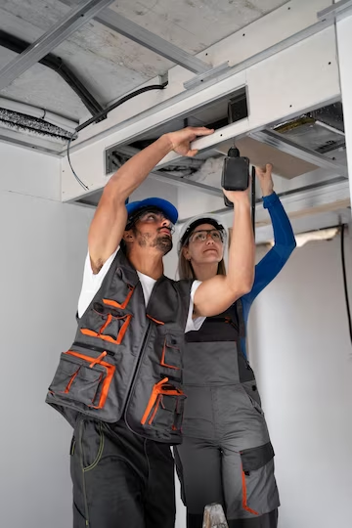
  Regular Maintenance:
After installation, perform regular maintenance, including cleaning or replacing filters, inspecting and cleaning coils, and inspecting for refrigerant leaks. Proper maintenance will help your system run efficiently and prolong its lifespan.
  Professional Installation:
Unless you have knowledge of HVAC systems, it's generally best to employ a professional HVAC mechanic to install your air conditioner. They have the knowledge and tools to ensure a proper and safe installation.

Slide 7
Conclusion:
Proper air conditioning installation is crucial for the long-term efficiency and effectiveness of your cooling system. It's a significant investment, and taking the time to install it correctly can lead to lower power bills, increased comfort, and a longer lifespan for your Air Conditioner.

Slide 8




CONTACT US
https://healdmechanical.com
916-972-7276
info@healdmechanical.com
P.O. Box 601505 Sacramento, CA 95860

Slide 9
THANK YOU

