Slide 1
Access Certification
Enhance security with access certification. Our platform streamlines user access reviews ensuring only authorized individuals have the necessary permissions.

Slide 2
Access Governance
Ensure compliance and security with access governance, allowing your organization to manage user access and permissions effectively, minimizing security risks.

Slide 3
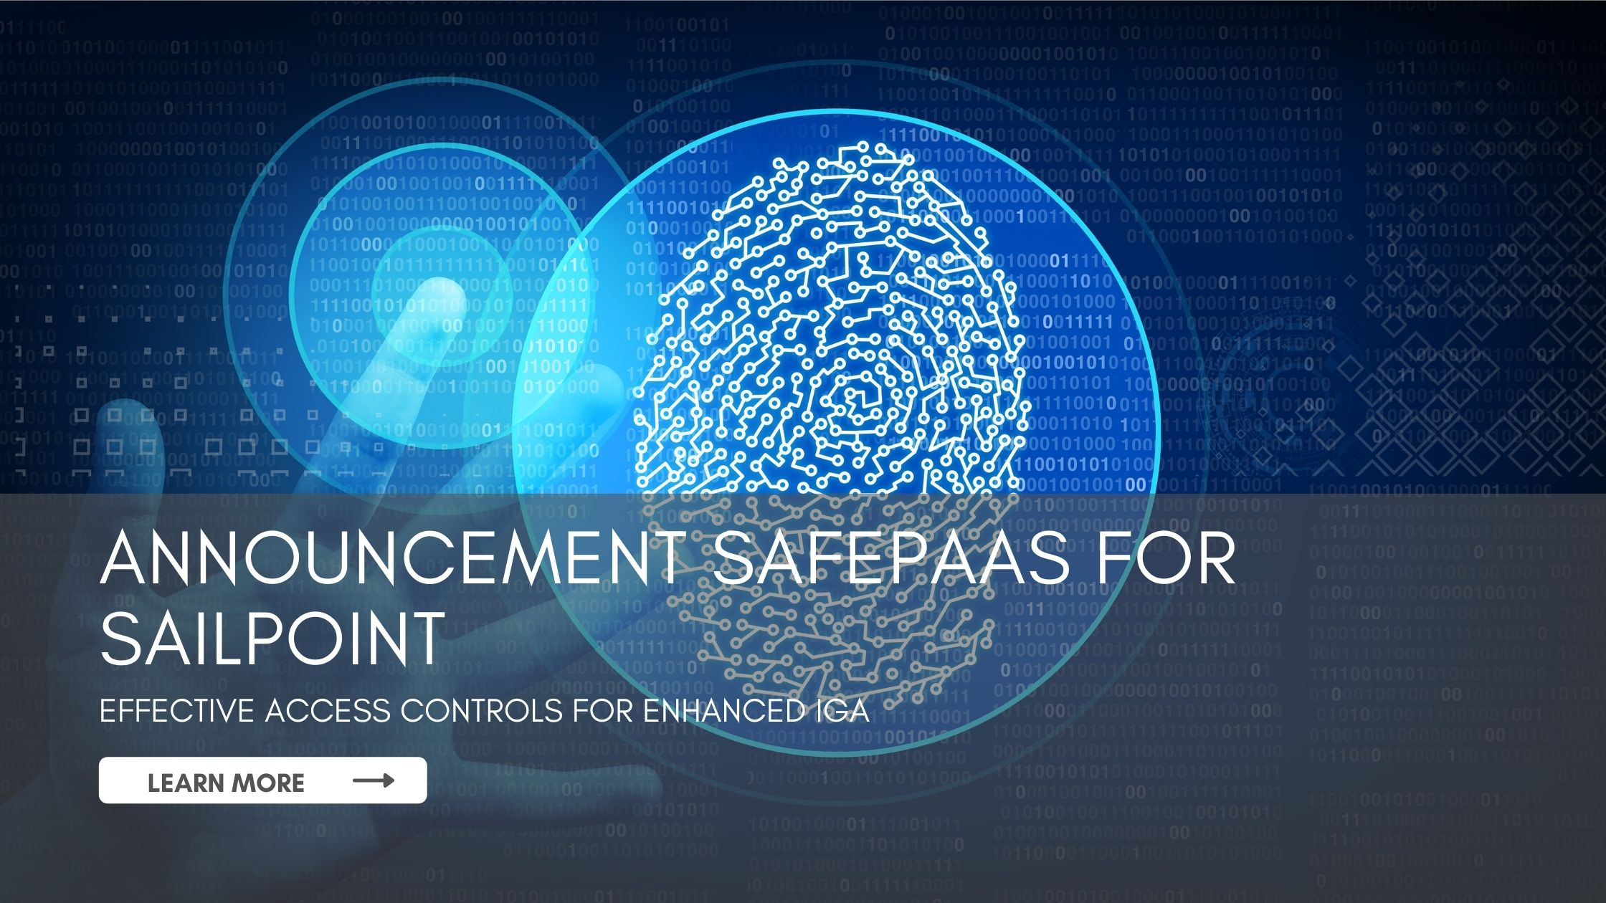
Identity Governance
Secure your systems with advanced identity governance. We offer tools to manage user identities and access controls, maintaining strict oversight & compliance.

Slide 4
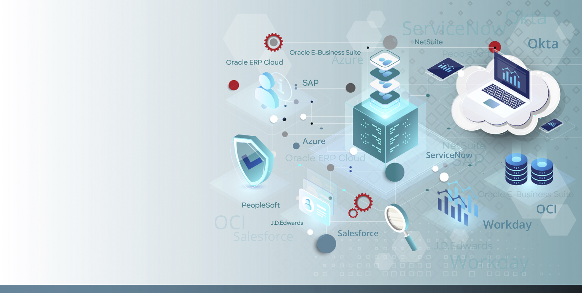
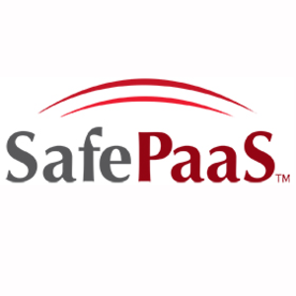
CONNECT
With Us
We can provide policy-based access control and risk aware access management, which is required to mitigate risk and provide value to the business. Contact us!
https://www.safepaas.com/
3300 Dallas Parkway, Suite 200, Plano, Texas 75093, USA
bizdev@safepaas.com
510-270-2460

