Slide 1
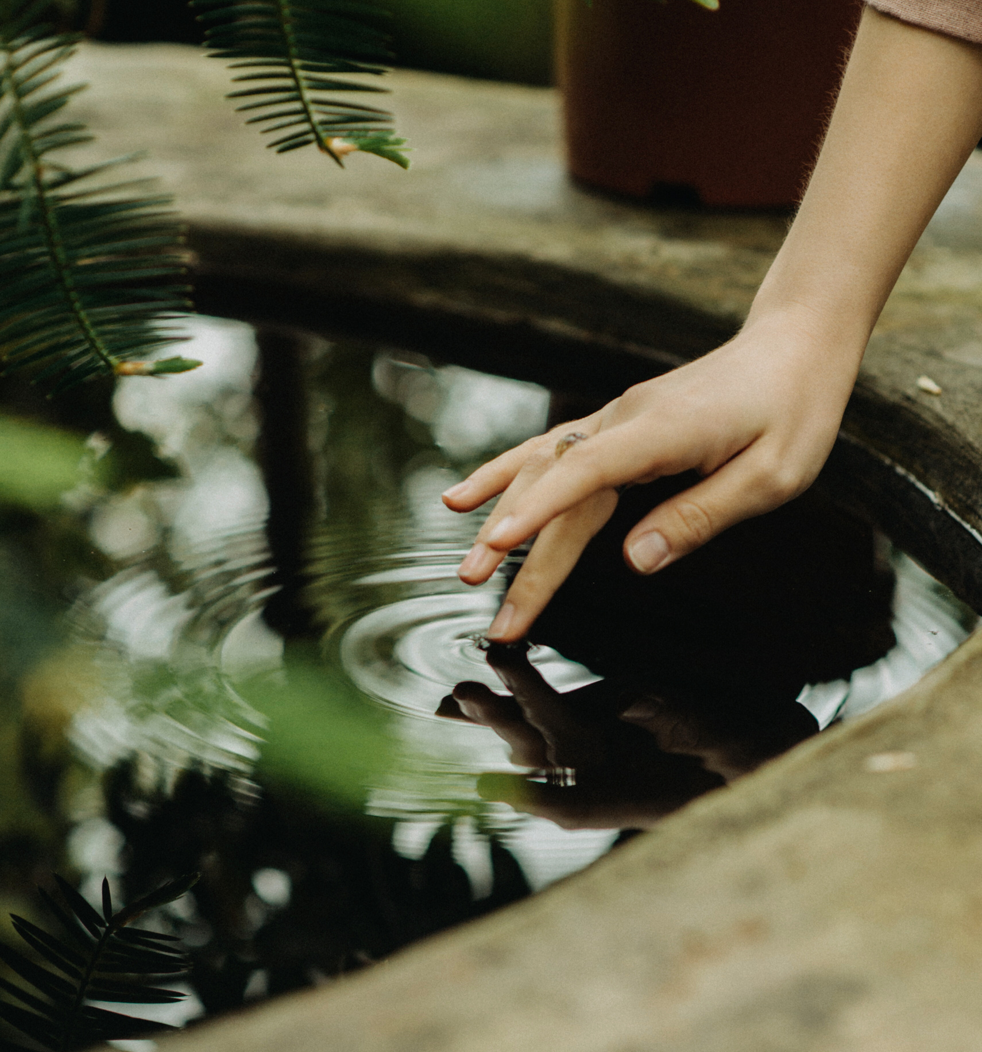

What is the Process of Drilling a Water Well?

Slide 2
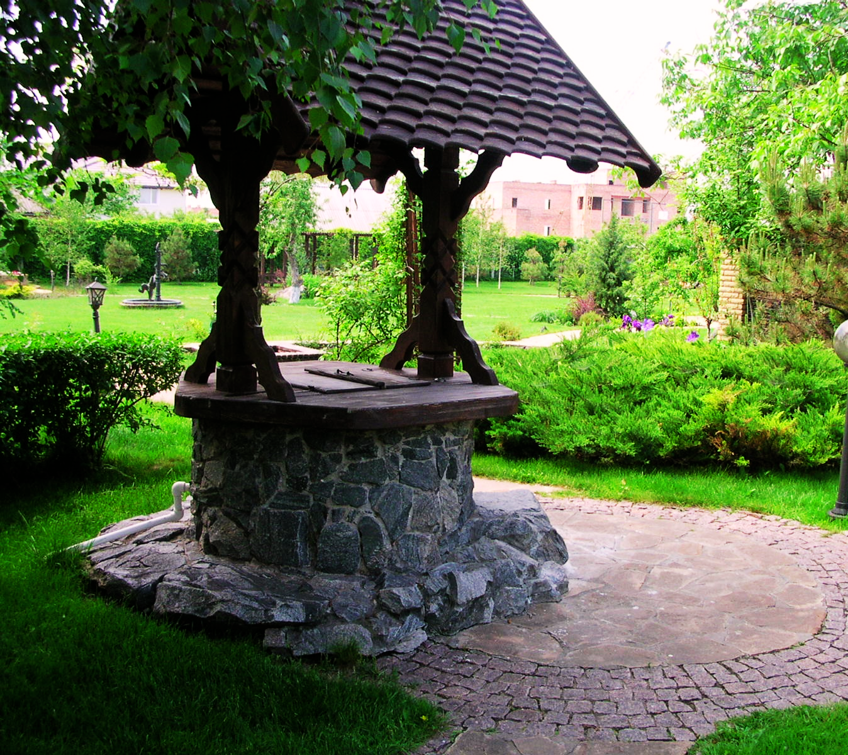
In addition to offering you a step-by-step tutorial on how to drill a water well, we'll also share some insightful advice to help you complete the project successfully and affordably. Let's take a sneak peek at the drilling of a water well!

Slide 3
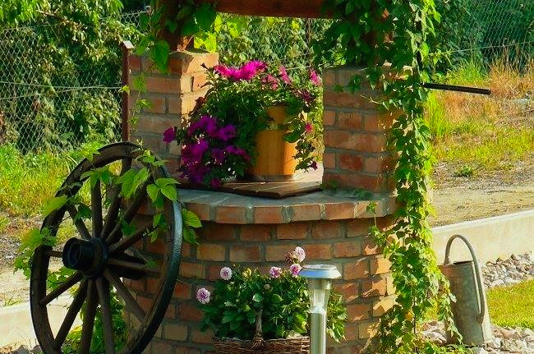
Steps to Consider When Drilling a Water Well!
The safety of your project is ensured by hiring knowledgeable water well drilling specialists. Depending on where you are, search online for "water well drilling specialists." Ask for advice from your family, friends, or even local farmers who have drilled their own water wells. For advice, speak with the county's environmental health or groundwater resource management agencies.

Slide 4
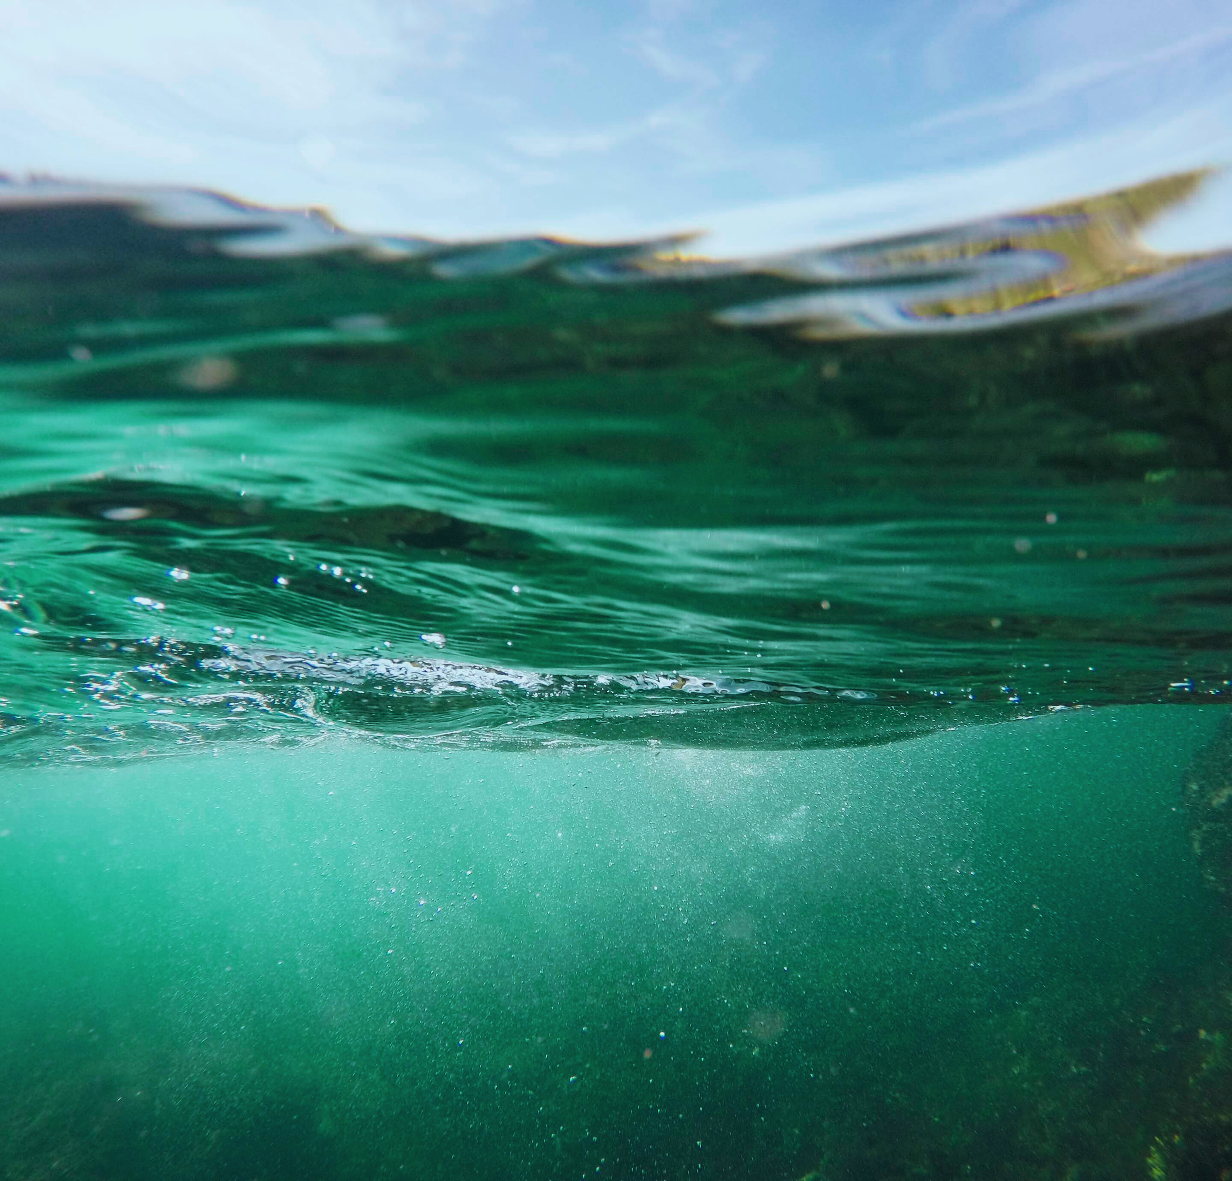
Determine the Water Availability:
Contact the local best water well drilling specialists, or other nearby areas for this. And follow the following steps:
  Geological Considerations
50
  Accessibility
40
30
  Proximity to Potential Contaminants
20
10
0
Element
Element
Element
Element
Element

Slide 5
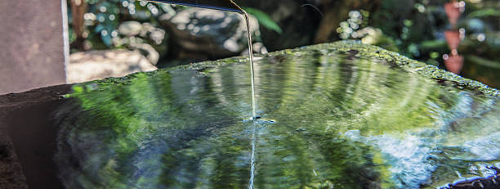
Obtain the Required Permits:
Typically, the permits include things like drilling, building, and well testing. Once more, your neighborhood Carson City, NV water well installation experts can guide you through the permit procedure and make sure you have all the required paperwork before you begin the project.

Slide 6



Choose the Right Equipment and Tools:
03/
Drill Bits
01/
Drilling Rig
04/
Casing and Screen
02/
Mud Pump

Slide 7
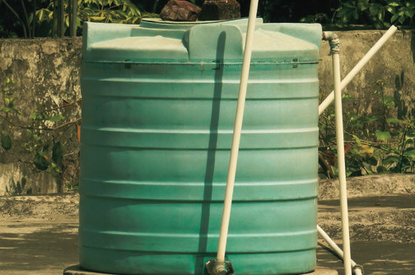
Install Water Tank Products:
The selection of water tank products is the following step after the well has been drilled. Tanks holding water, pumps, and filtration systems may be part of it. These items contribute to keeping the water hygienic, secure, and accessible.

Slide 8
Thankyou
Visit the link
How to Drill a Water Well?

