Slide 1



Get the Best Tips for Water Well Maintenance

Slide 2


For the durability, health, and safety of your system, water well care is essential! Neglecting its maintenance can result in a variety of problems, including tainted water, decreased water flow, and expensive repairs or replacements. Therefore, it is wise and will pay off in the long run to put up the time and effort necessary for adequate maintenance.

Slide 3

Schedule Regular Inspections
Monitor Water Quality
Water Well Maintenance Tips.......
Maintain the Area Around Your Well
Check for Leaks
Test Your Well Pump
Protect Against Freezing
Keep Records
Schedule Professional Maintenance

Slide 4
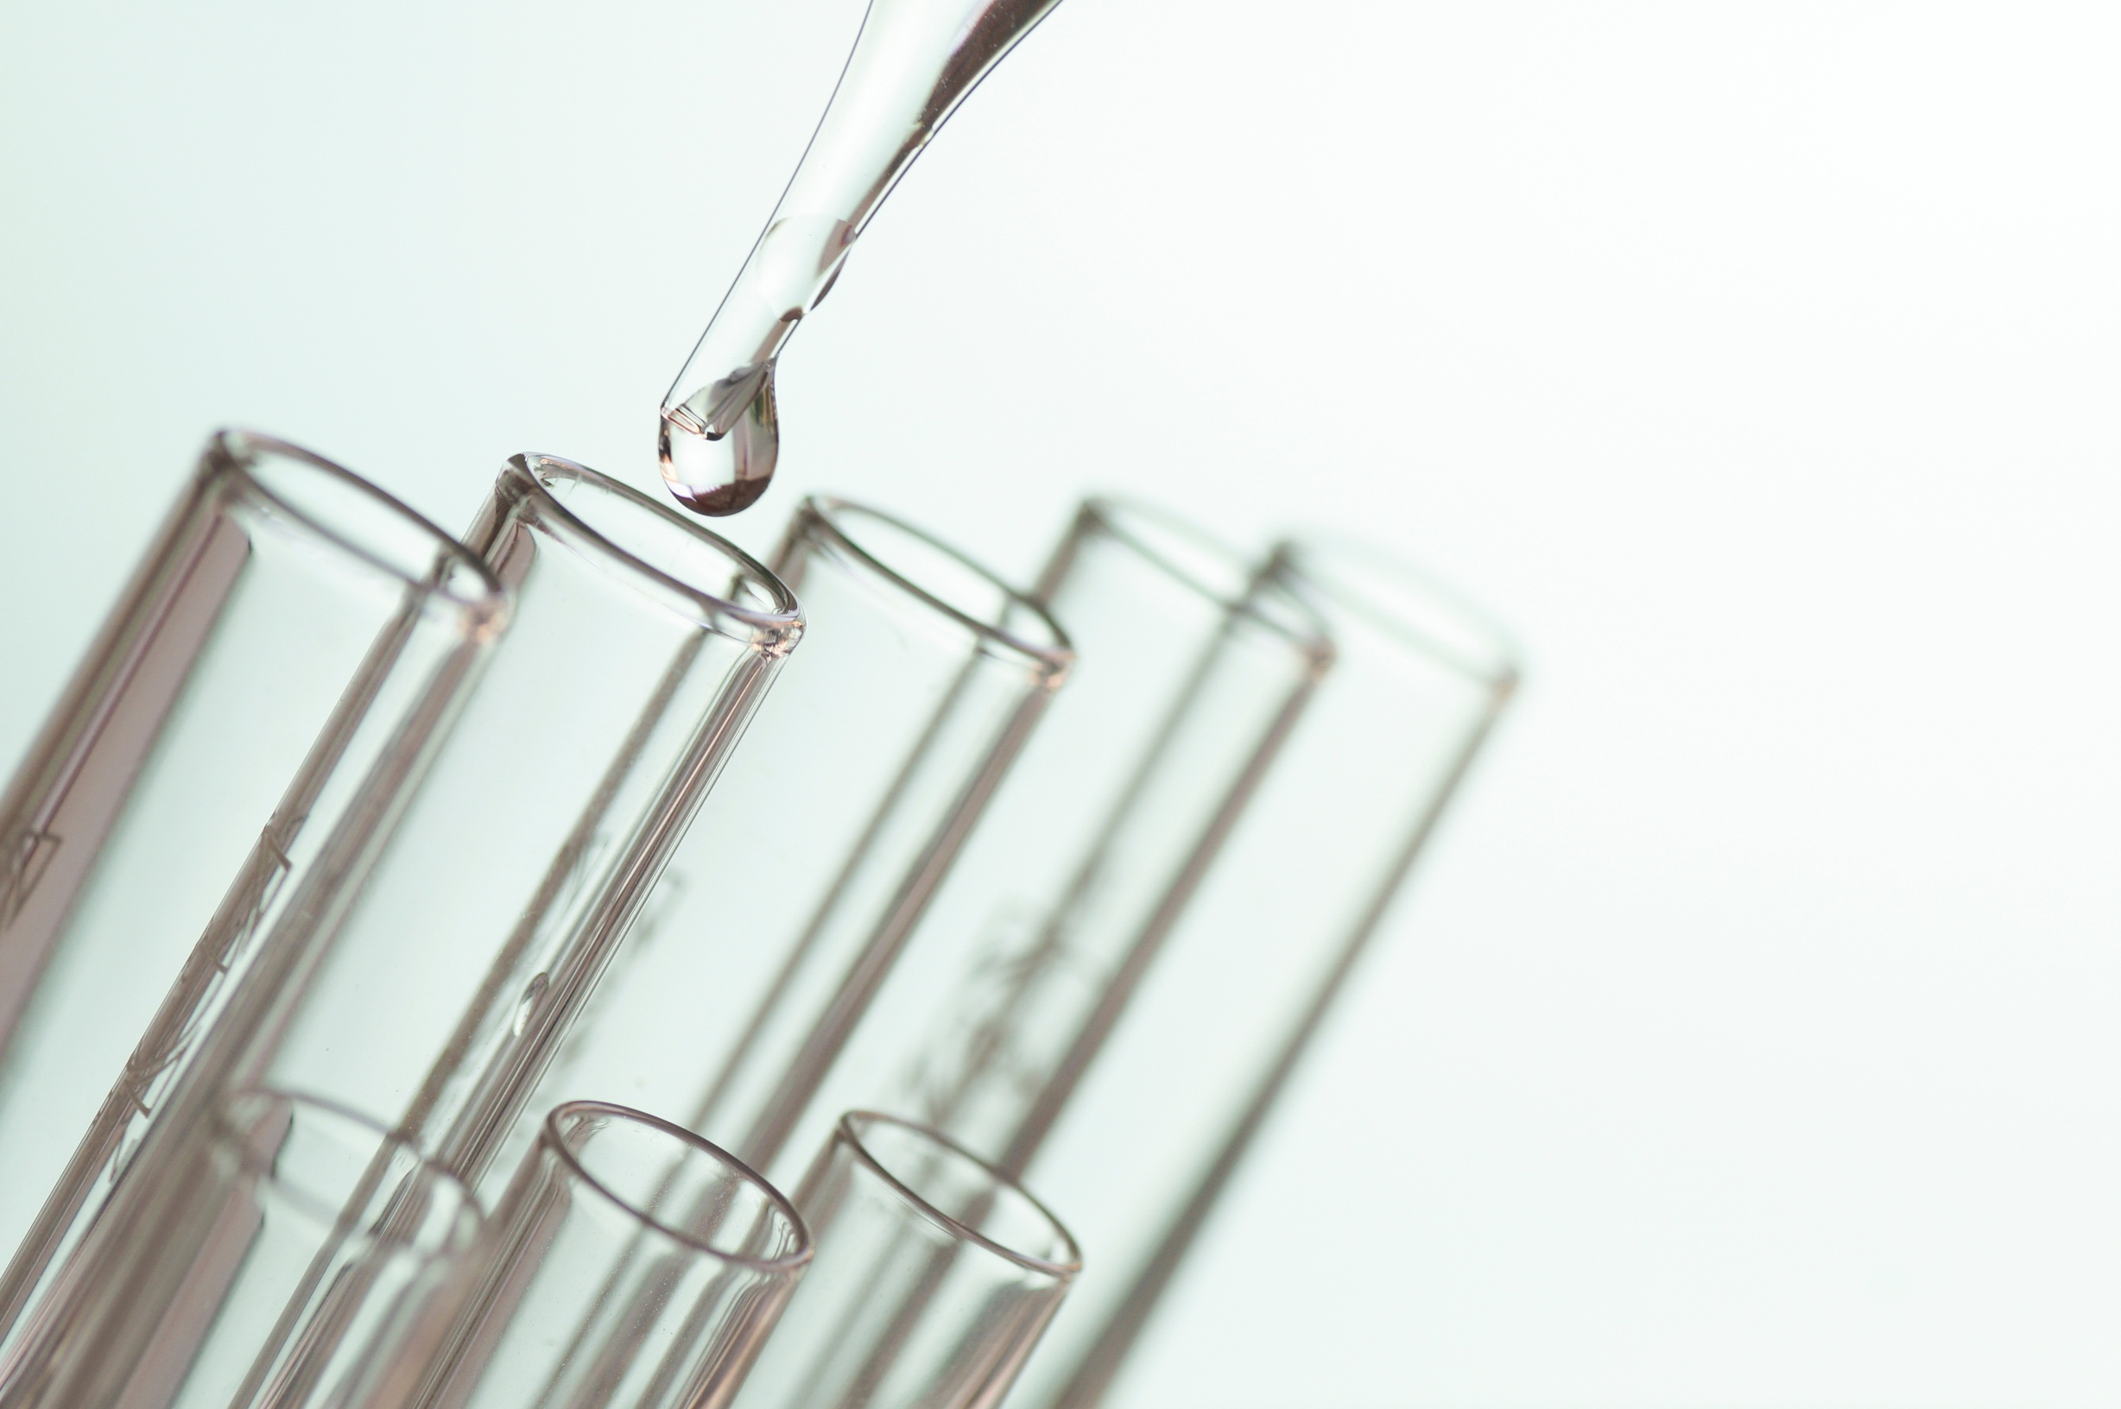
Schedule Regular Inspections
Regular inspections are required to ensure an effective water well process. Hire experts to carry out routine inspections and help you spot issues before they worsen.

Slide 5
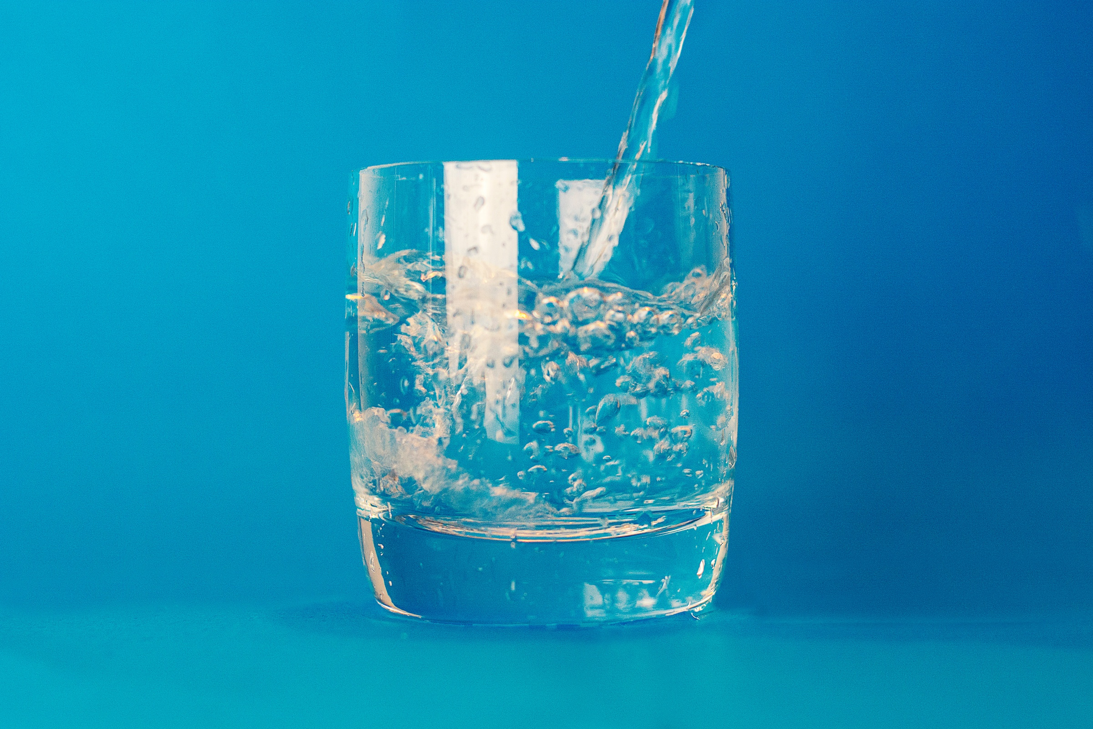
Monitor Water Quality
The health of your family depends on the quality of your well water. As a result, it needs to be regularly checked for pollutants including bacteria, nitrates, and other poisons. If problems arise, speak with a water well expert to look into potential fixes. Water testing on a regular basis ensures that your water is safe and free of harmful substances.

Slide 6

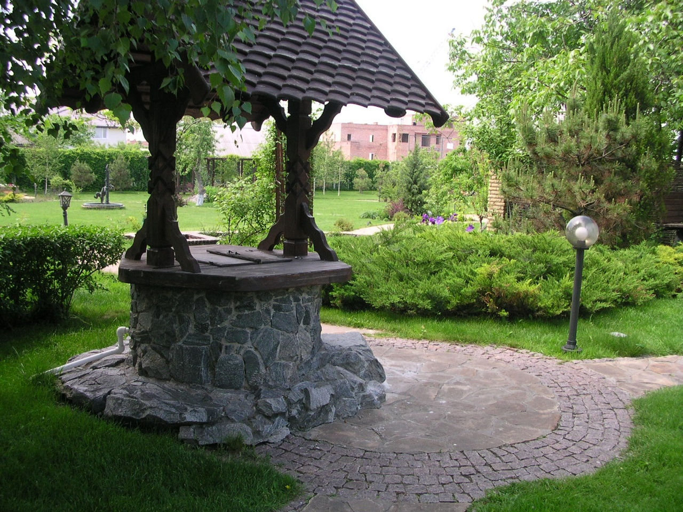
Maintain the Area Around Your Well
Toxins entering your water well can be stopped by properly protecting the wellhead. Consider the following safety measures to safeguard your water supply:
○ Create a Wellhead Protection Zone:
○ Install a Concrete Pad:
○ Plant Vegetation:

Slide 7


THANKYOU FOR WATCHING
FOR MORE INFORMATION VISIT THE LINK
HOW TO MAINTAIN A WATER WELL

