Slide 1



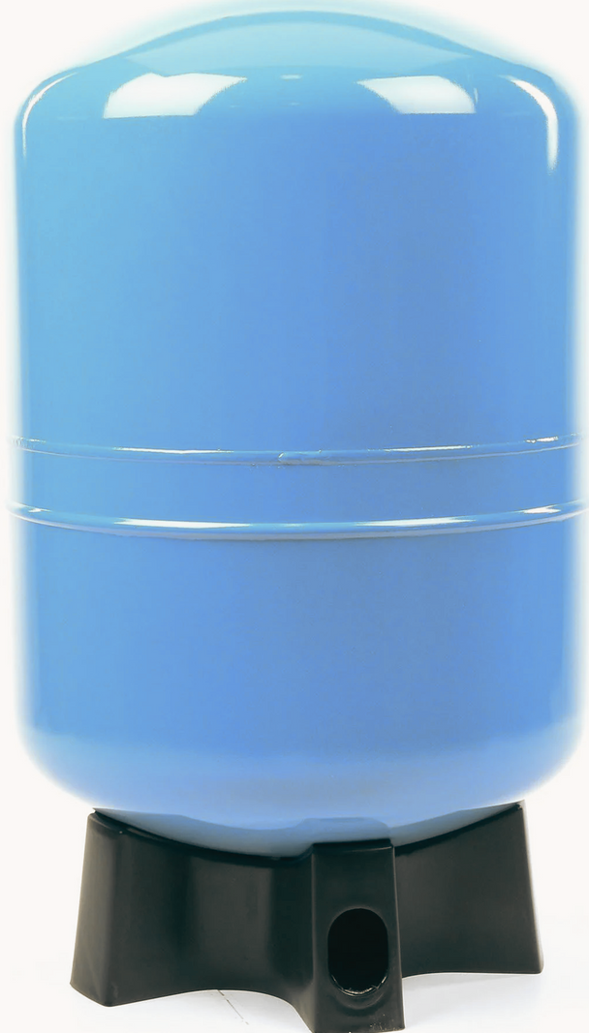
REASONS FOR PRESSURE LOSS IN A PRESSURE TANK

Slide 2

Pressure tanks frequently lose pressure over time, which frustrates us. To assist you in effectively repairing the issue, we've looked at some of the most common causes of pressure loss in water tanks. In Reno, NV, water tanks are essential in keeping a constant water supply for homes and industries, mainly in places where water well pumps are regularly utilized. If water pressure tanks lose their pressure it can be a big problem for everyone.

Slide 3
Understanding Pressure Tanks and Their Significance
Two important goals are to keep the water pressure constant and lessen how often the water pump cycles.

Slide 4

Common Causes of Pressure Loss in Water Tanks
1
Insufficient Air Pressure
2
Waterlogged Tank
3
Leaks in the System

Slide 5
Insufficient Air Pressure:
As the pump fills the tank with water, the air inside the chamber is compressed, creating the pressure that forces the water through the pipes and out of your faucets. The air chamber may lose the desired pressure as air slowly dissolves into the water. A malfunctioning air valve or a diaphragm/bladder that is damaged is to blame. The air pressure inside the tank must be frequently checked as part of the troubleshooting process.

Slide 6

Waterlogged Tank:
when water instead of air fills the tank's air chamber, which can happen if the tank's diaphragm or bladder is damaged and allows water to enter the section. It makes tanks soggy. A proper diagnosis and replacement can be ensured by consulting experts knowledgeable in Fallon, NV, water well pumps, preventing further problems.

Slide 7
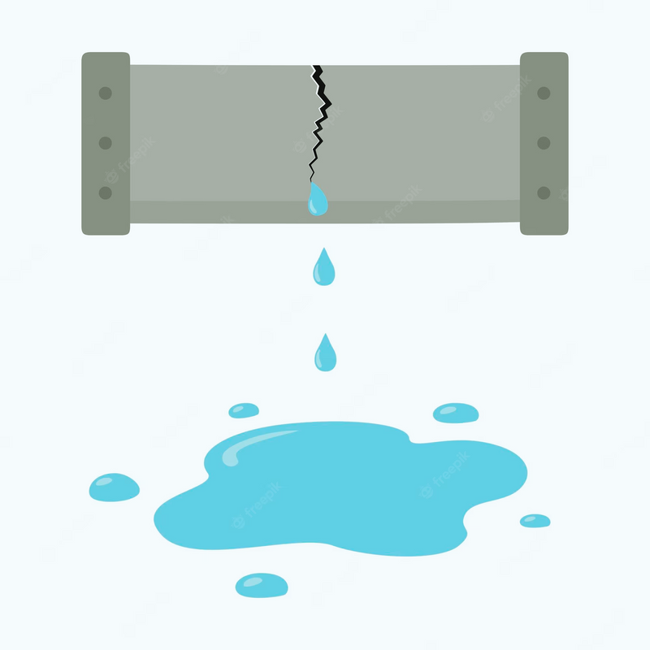
Leaks in the System:
Pressure loss can occur over time as a result of minor leaks in fittings, valves, or pipelines. Both the supply line and the distribution line in your home may experience these leaks. A professional plumber should be consulted if the leaks are not obvious or easily accessible in order to complete a comprehensive investigation and any required repairs.

Slide 8
Conclusion
Remember, if you're unsure or if the problem persists, don't be afraid to seek help from professionals who are familiar with water tank products and systems.

Slide 9
﻿THANK YOU
Visit Now
What Causes a Pressure Tank to Lose Pressure

