Slide 1


WHICH PROCEDURE IS USED FOR DRILLING WATER WELLS?

Slide 2
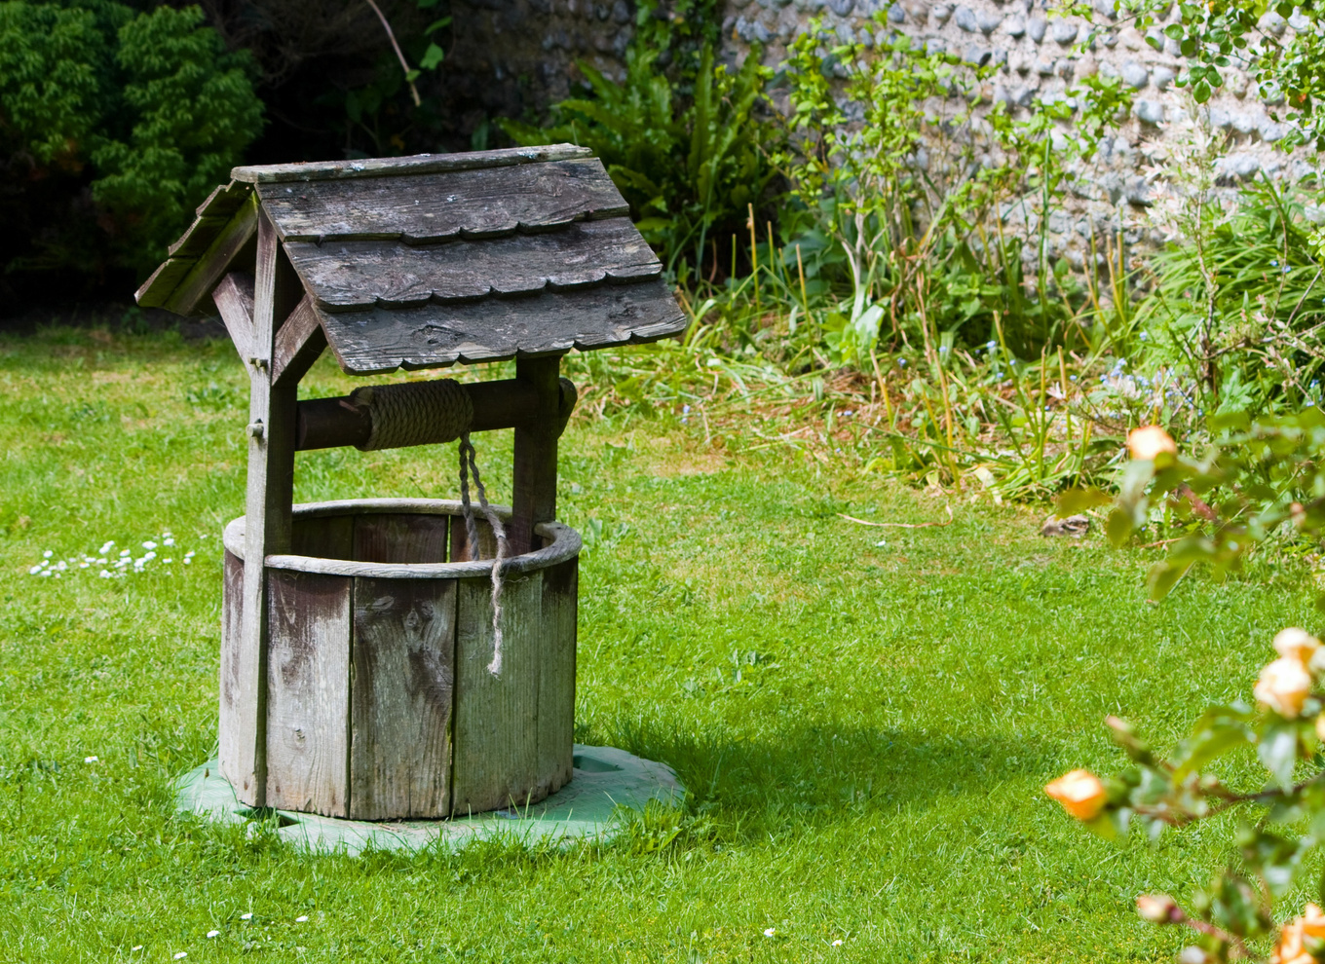
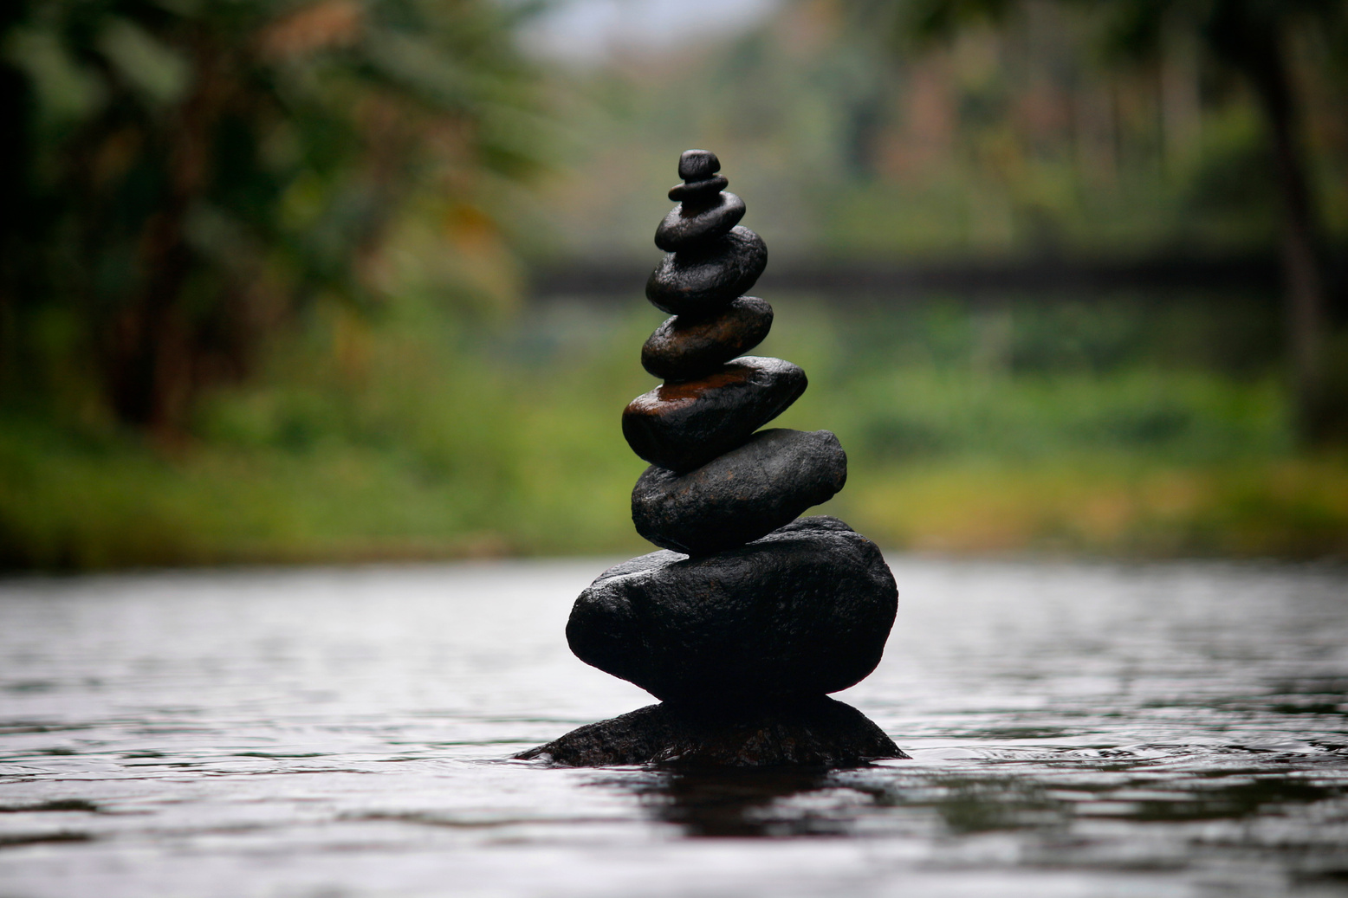

You may be familiar with what a water well is, but you may not be aware that subsurface aquifers hold over 97% of the world's freshwater, and to gain access to that water, most homeowners opt to install a private water well. In addition, water well installation specialists in Carson City, NV, can drill wells for various purposes, including gauging water quality, for heating&cooling purposes, and providing drinking water when cleaned.

Slide 3

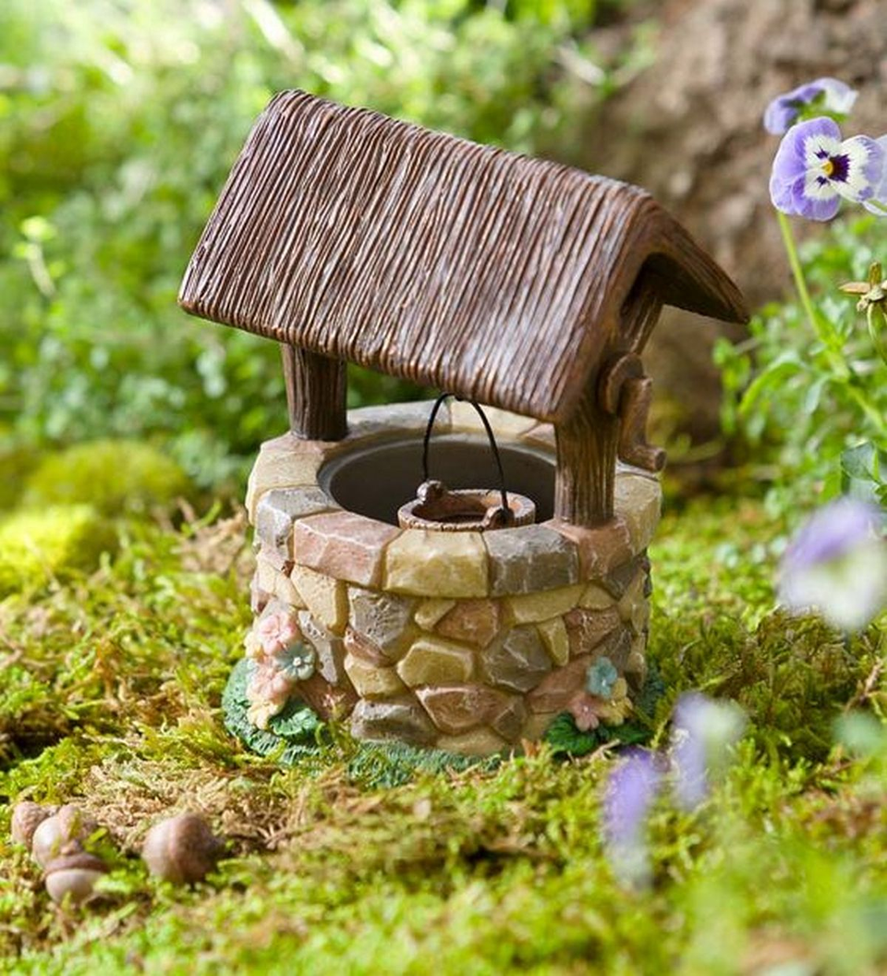
A Guide to Drilling a Well

Slide 4

Determining the Drill Location:
Access to power and convenience are two critical factors to consider when deciding the site of a well. You should also call the relevant utility providers to check that no subterranean pipelines or lines are close. The location of any septic system or barn drainage must be away from the well.

Slide 5
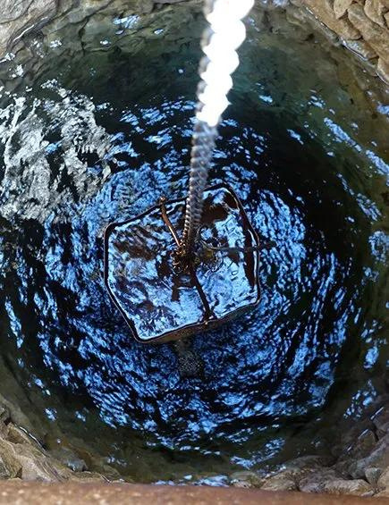
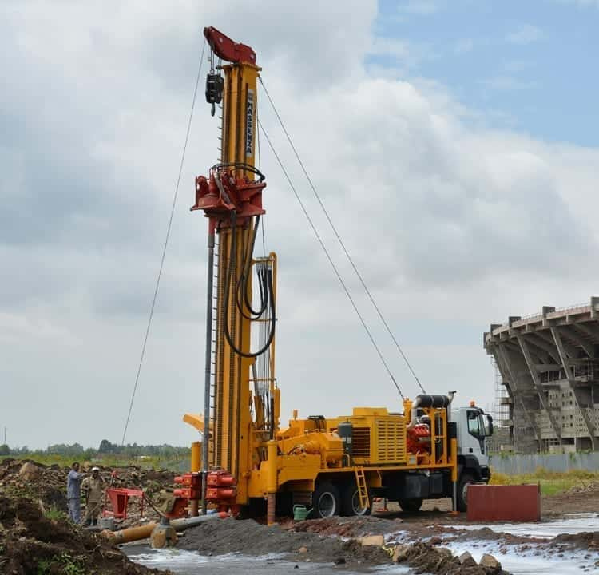
Water Well Construction:
Water well digging reserved for private property in areas lacking municipal or rural water supplies. While you may engage qualified water well drilling Fallon, NV specialists for this job, it will cost you a lot of money.

Slide 6
THANK YOU
VISIT NOW
HOW TO DRILL A WATER WELL?

