Slide 1

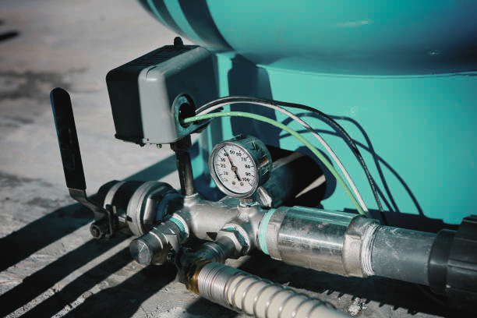

HOW LONG DOES A GOOD PRESSURE TANK LAST?

Slide 2


In a private water system, a pressure tank stores water and acts as a backup water supply. It comes in various sizes and is made of metal, steel, or fiberglass. Because of advanced technology, we put in a new pump with a pressure tank. When your home needs water, a pressure tank stops your pump from turning on and off suddenly. For water tank products, you may get in touch with an expert.

Slide 3
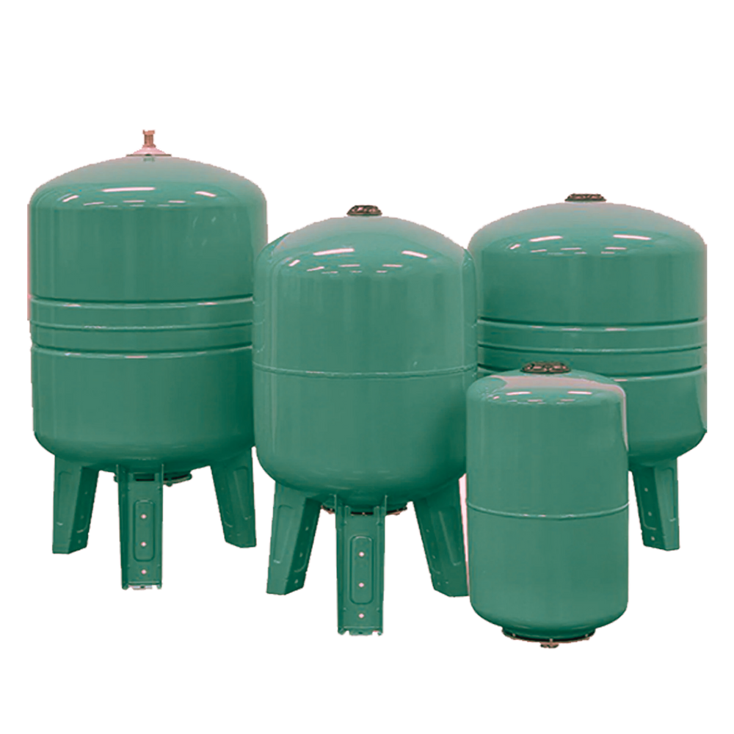
Factors Affecting Pressure Tank's Durability
01
Development of Corrosion
02
Poorly Made Pressure Vessel Materials

Slide 4

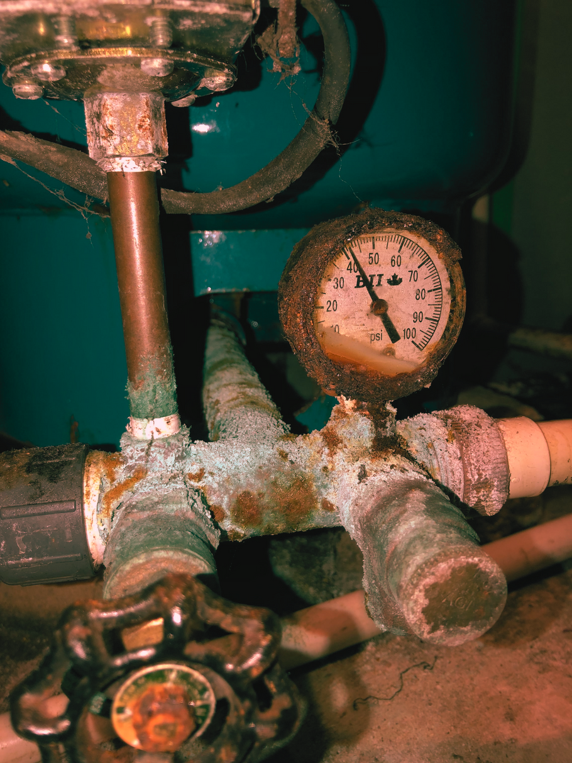
Development of Corrosion:
One of the frequent issues in a pressure tank is corrosion. If corrosive substances are present in the pressure tank, corrosion will occur more quickly.

Slide 5


Poorly Made Pressure Vessel Materials:
Pressure tanks are made by independent fabricators. Low-cost or poor-quality fabrication may have flaws.

Slide 6

Signs of a Pressure Tank Failure
01
Low water pressure
Excessive air in the plumbing
02
03
Unstable water pressure
04
Pressure tank leaks

Slide 7

THANK YOU
Visit Now
How Long Do Pressure Tanks Last?

