Slide 1
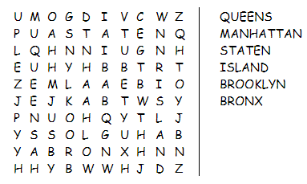
Warmup !
https://learningapps.org/watch?v=p666dv5p317

Slide 2
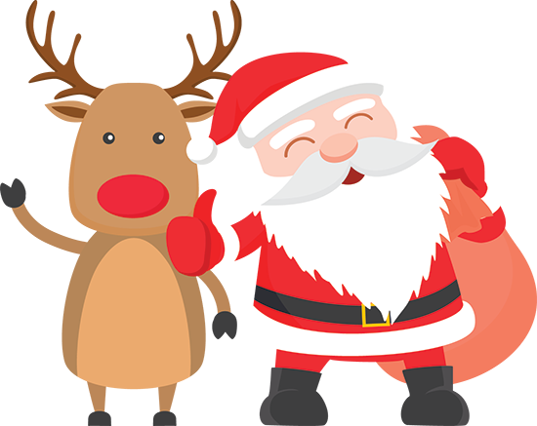
In 12 days it’s ………….
Christmas !

Slide 3
A christmas in NYC
Avant de quitter New-York, célébrons Noël !

Slide 4




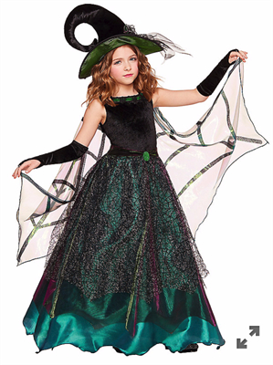
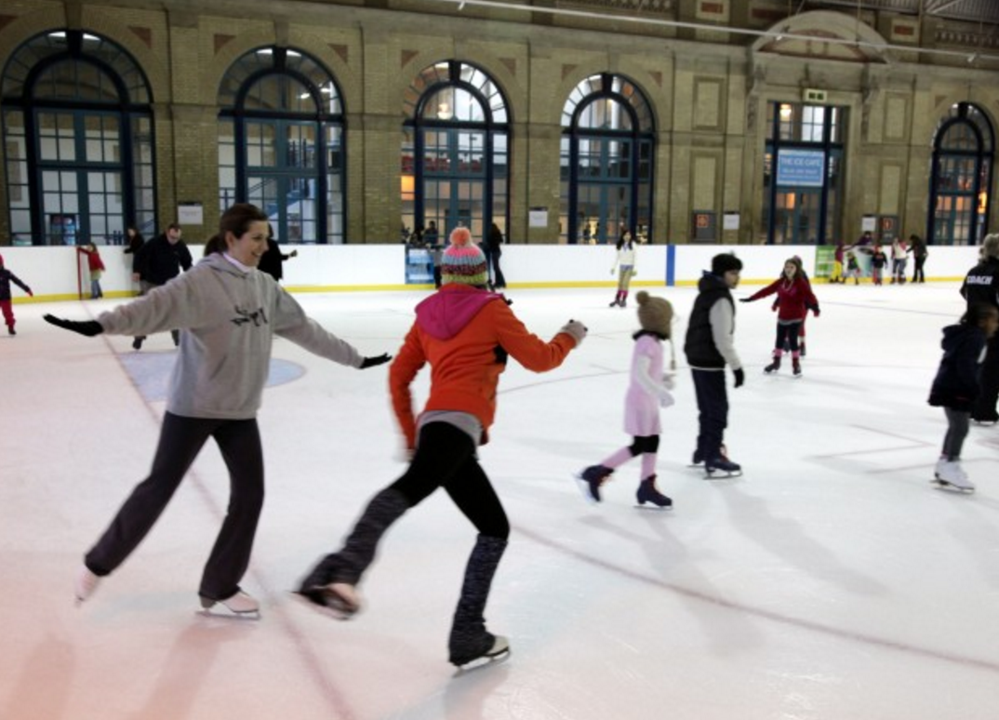
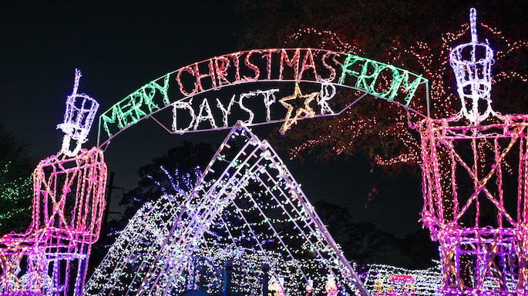
What do you think New Yorkers do for Christmas ?
- I think they …
Go swimming
Eat at a restaurant
Go shopping
Go ice-skating
Watch Christmas lights
Wear costumes

Slide 5




TOP 5
Video time !
Things to do for Christmas in
New York City

Slide 6

Video time !
Tu vas regarder attentivement une vidéo en 5 parties. Tu dois :
  Compléter le titre de chacune des parties.
  Cocher les éléments que tu vois.
  Attention aux intrus !

Slide 7
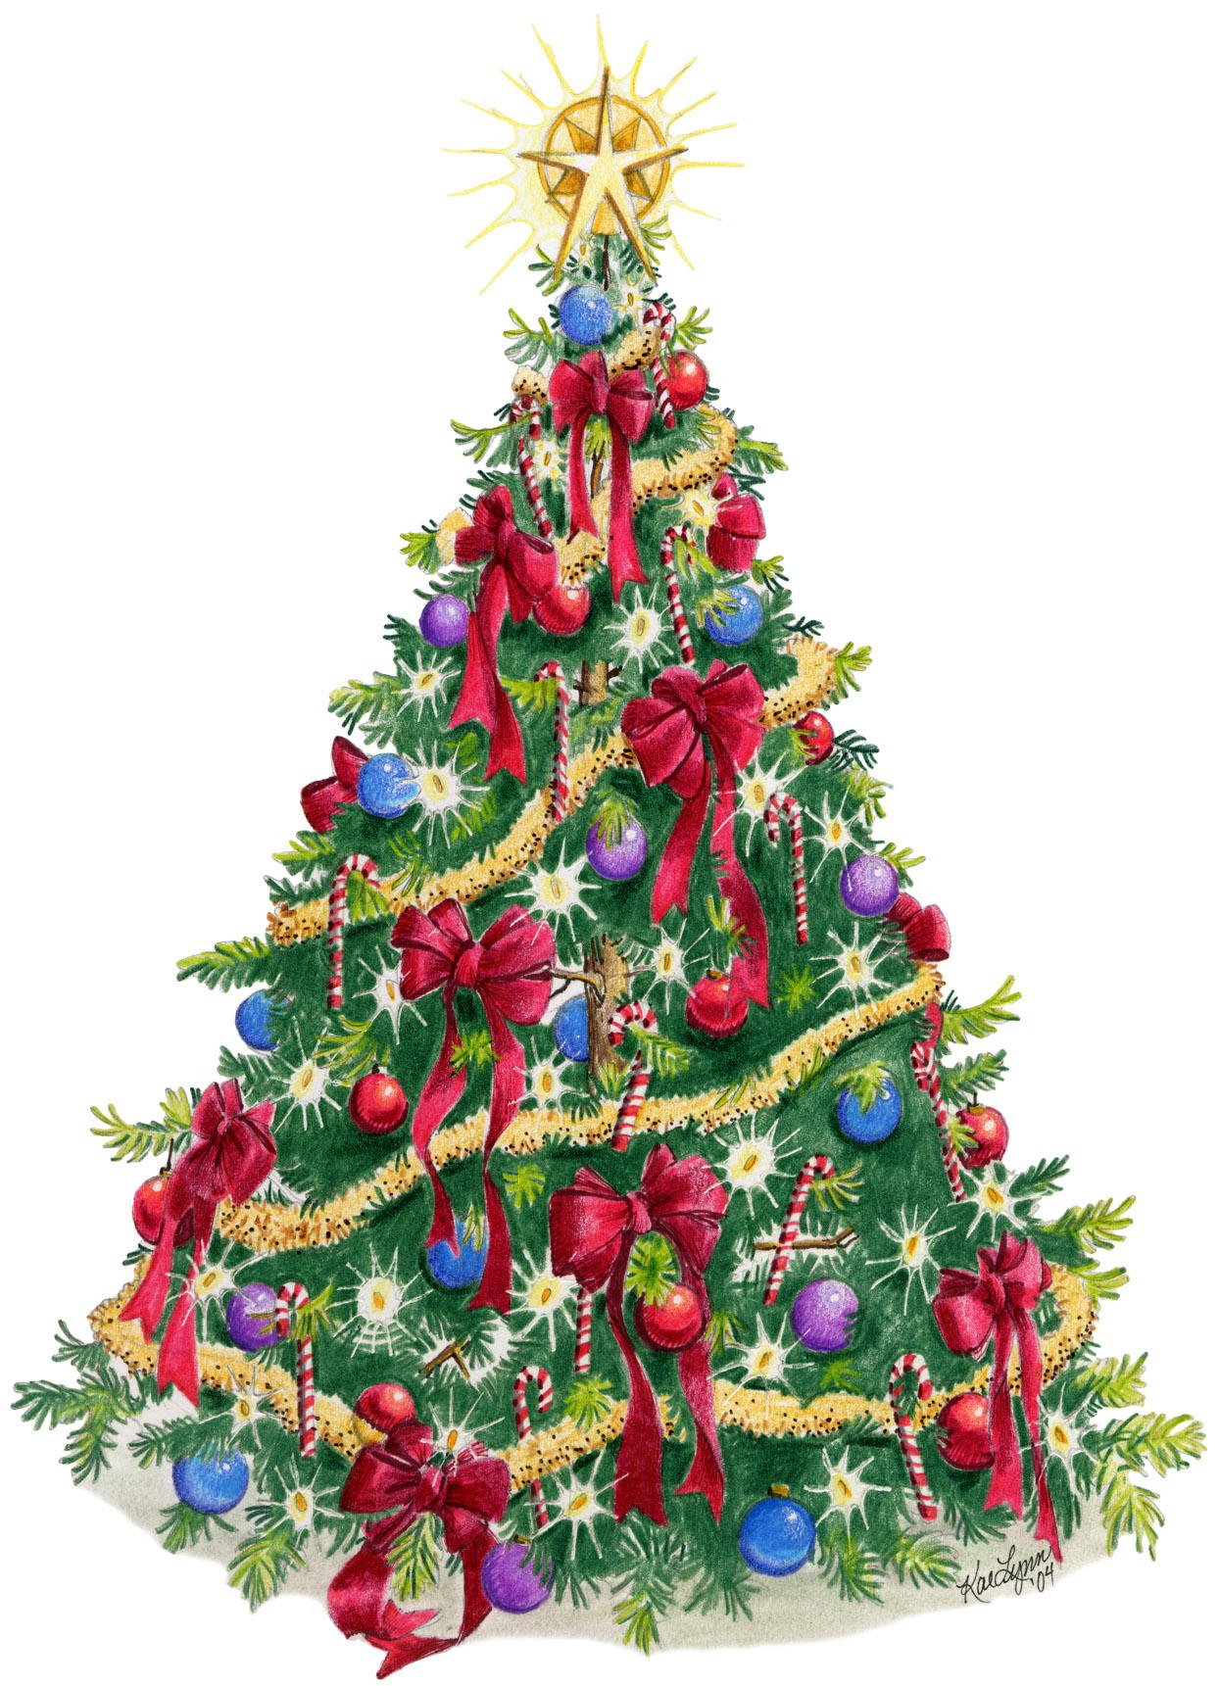





1- Watch the Rockefeller center ………………………………………
Christmas tree
I can see ……
Christmas lights
A small Christmas tree
A big Christmas tree
A Christmas star
A snowman

Slide 8
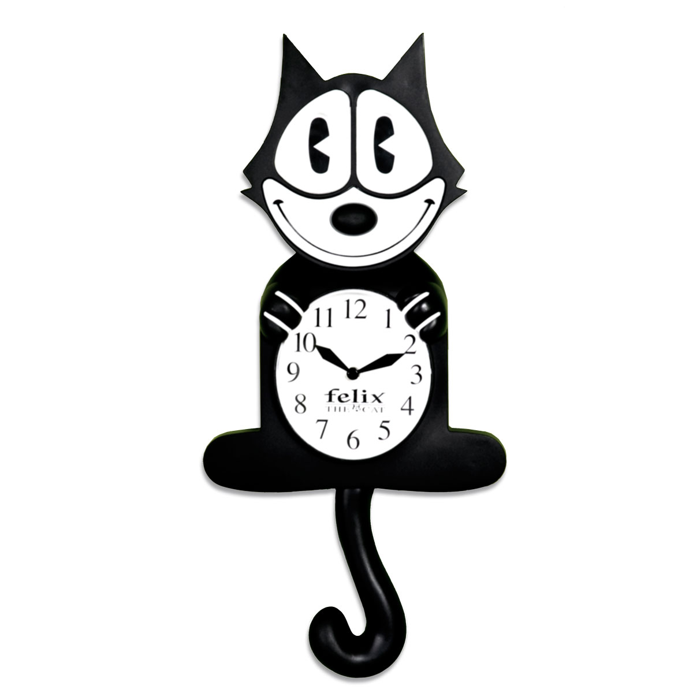
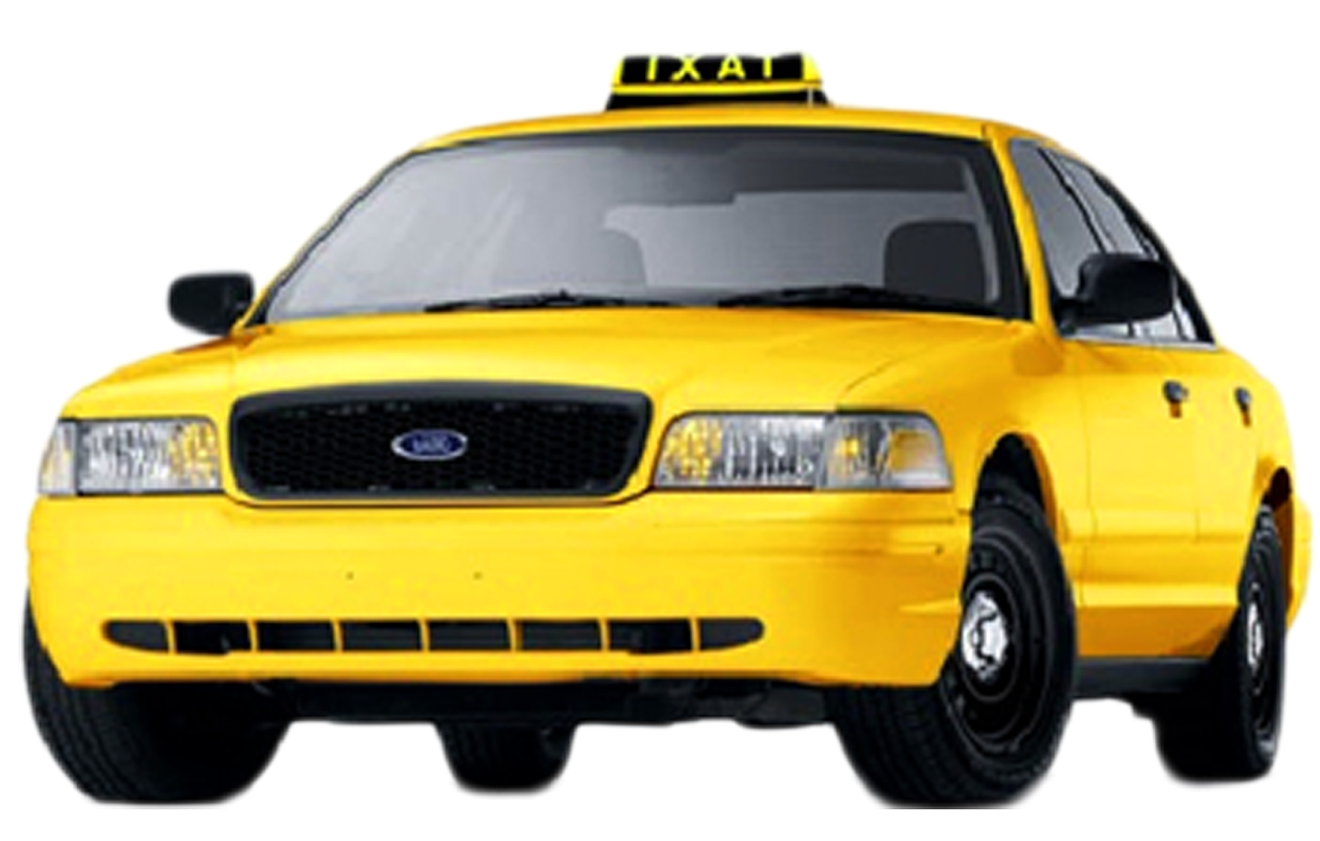



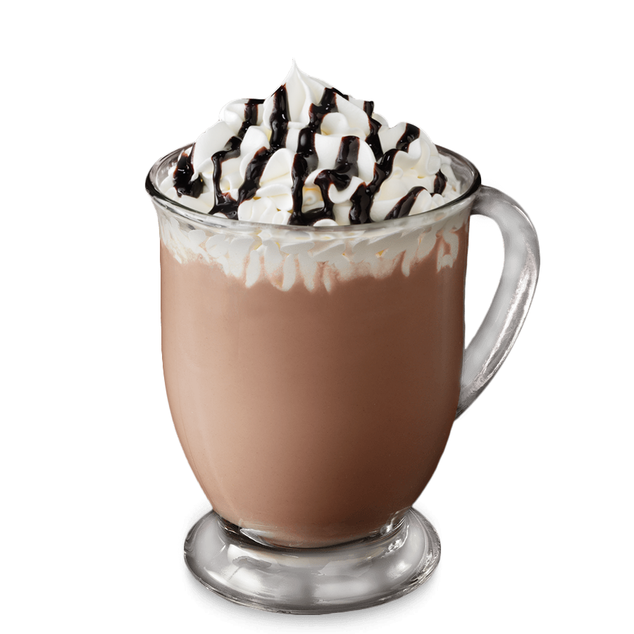
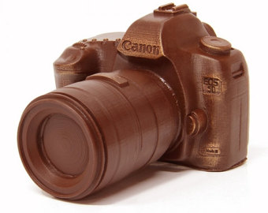
2- Visit Bryant Park Winter ………………………………………
village
I can see ……
A yellow cab
Ice skaters
Food
Gifts / Souvenirs
A Christmas tree
A snowman
A chocolate camera
Hot drinks

Slide 9
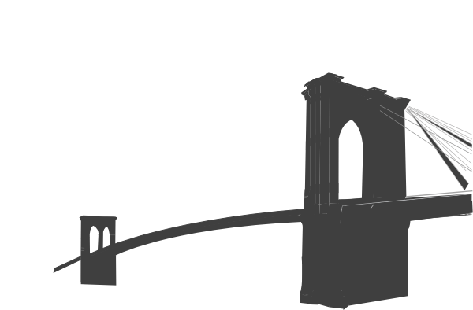
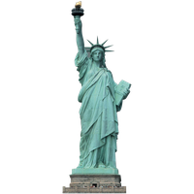


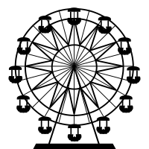
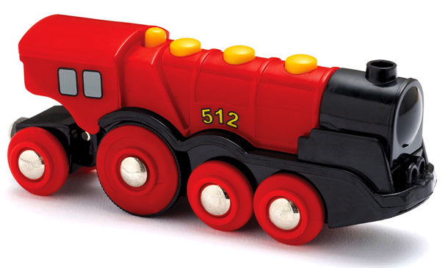
3- Watch the holiday …………………………… at the Botanical Gardens
train show
I can see ……
The New York Bridge
A reindeer
Plants
The Statue of Liberty
A toy train
A chocolate camera
A ferris wheel

Slide 10

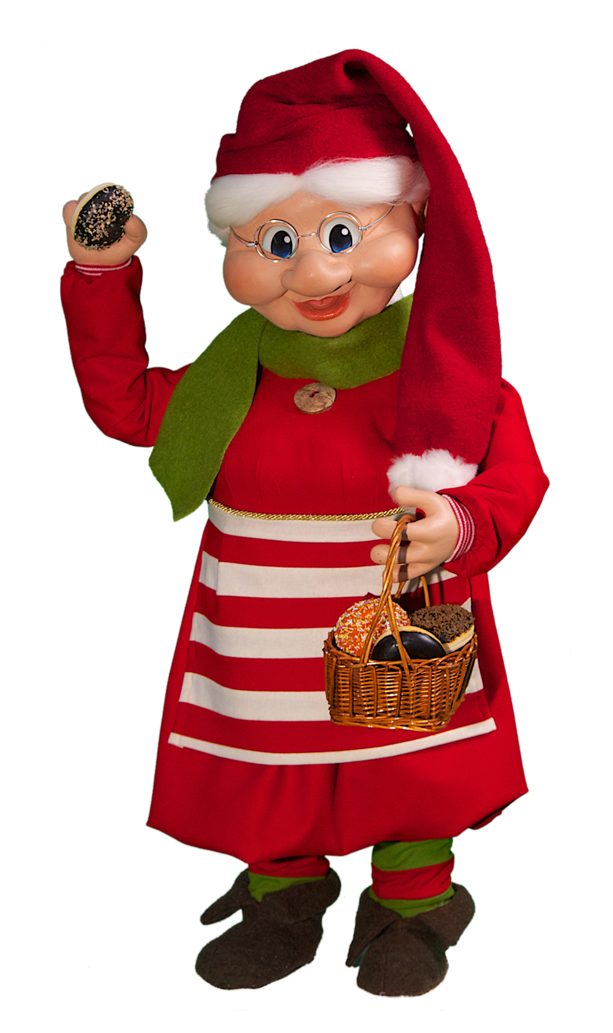

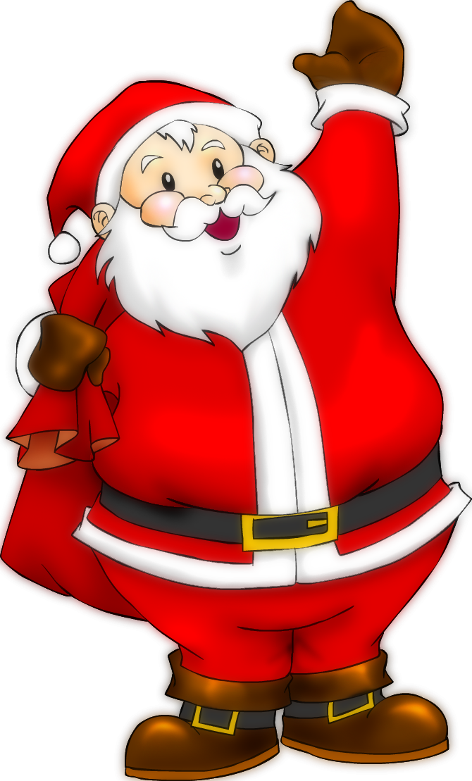


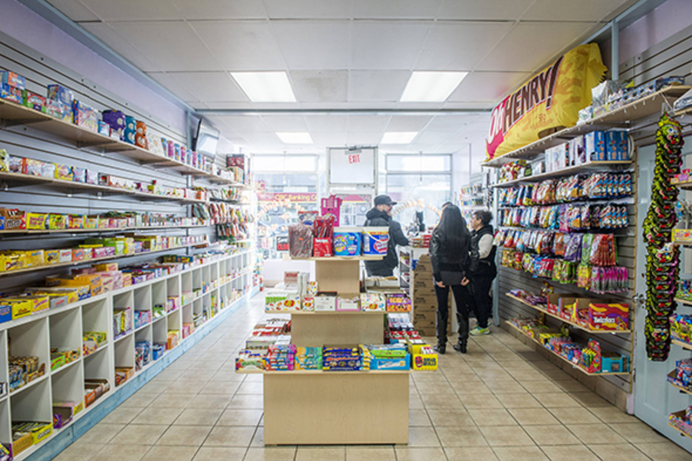
4- Admire …………………………… Christmas decorations.
Macy’s store
I can see ……
Christmas decorations
Miniature houses
The Statue of Liberty
Automatons
Miniature skyscrapers
A skier
Santa
Shops

Slide 11


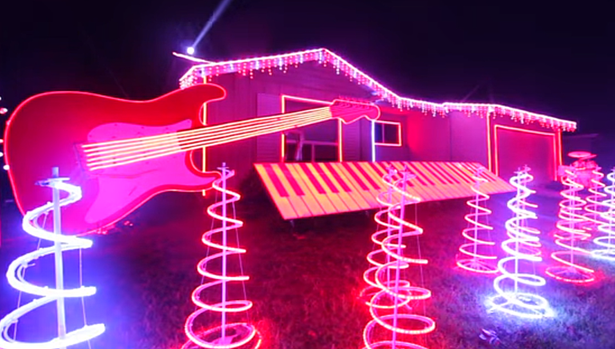

5- Watch Dyker Heights………………………………..
light show
I can see ……
Ice skaters
A candy cane
Snowflakes
A light and music show
Skyscrapers
A snowman
A Christmas tree
Christmas lights

Slide 12
You can watch the big Rockefeller Center Christmas tree. There are a lot of Christmas lights and a large christmas star on top of it !
You can visit Bryant Park Winter Village and buy gifts for your family and friends. You can also relax, have hot drinks and watch ice skaters !
You can visit the Botanical Gardens during winter, and see a toy train and a miniature of the New York Bridge and the Statue of Liberty.
You can go shopping at Macy’s store and watch the Christmas decorations and automatons. Don’t forget to visit the shops !
You can go to Brooklyn and see houses decorated with a lot of Christmas lights. The most beautiful house wins a prize !

Slide 13
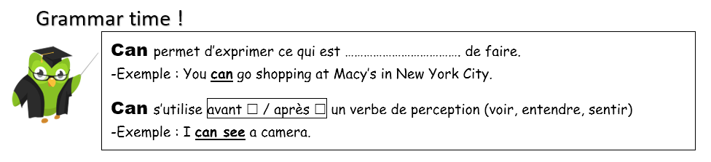

Slide 14



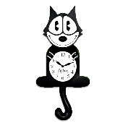

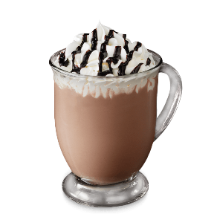
Role play !
Tu es dans le magasin de Macy’s pendant la periode de Noël. Un élève joue le rôle d’une personne qui est perdue dans le grand magasin de Macy’s et un autre élève joue le rôle d’un vendeur :
Good afternoon, I’m lost in the store ! Can you help me ?
Good afternoon ! Of course ! Where do you want to go ?
I’m looking for a ……
Oh, I see !
You need to go to the
Thank you very much, goodbye !
fifth floor →
fourth floor →
third floor →
second floor →
First floor →

