Slide 1

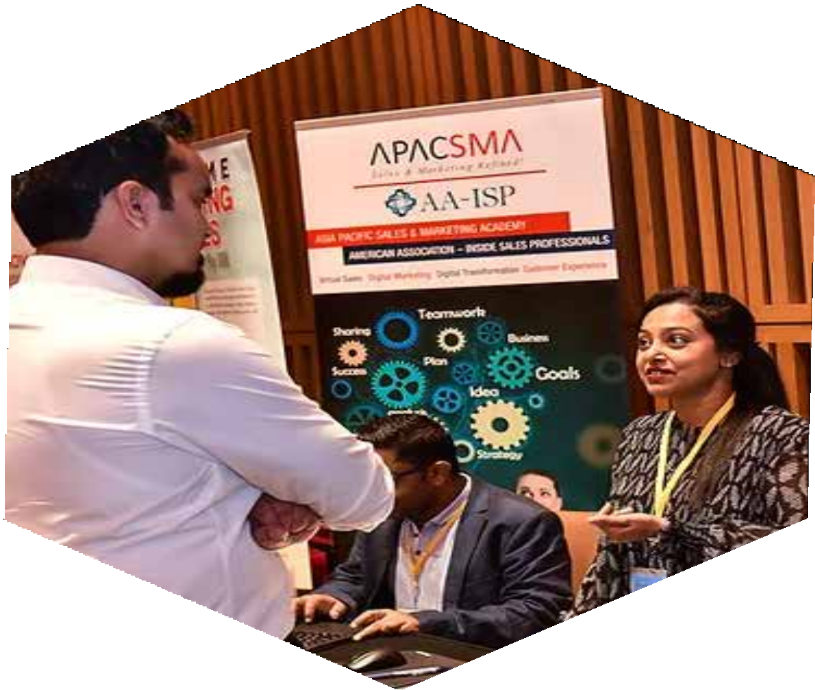
KUALALUMPUR
SUMMIT 2023
https://www.salesgasm.com

Slide 2
ABOUT US
Dubbed by many as the company with an outlandish name that sticks to the mind for an eternity, Salesgasm is a professional sales and marketing training facilitation company. Its mission is to make sure that the world has better and more efﬁcient sales and marketing professionals and no company/department has to close down because it was not able to market and sell its products/services. Many of the ﬁnest sales and marketing professionals from across the globe are a part of the Salesgasm family.
https://www.salesgasm.com

Slide 3
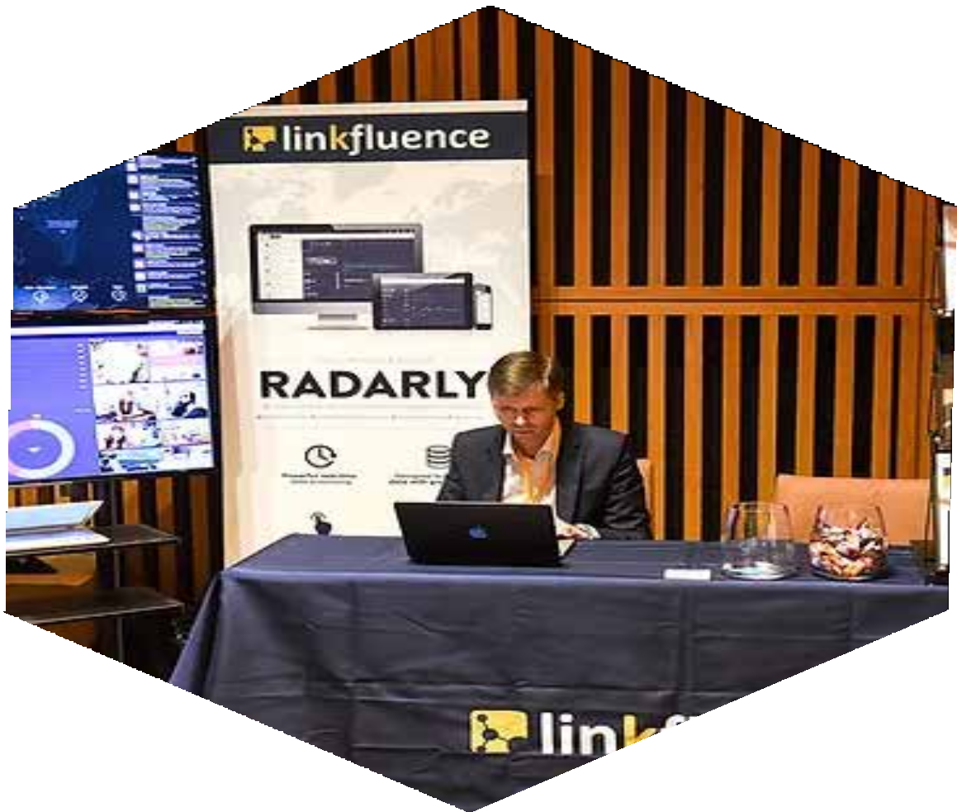
Today’s world has become digital and innovative. In this situation, busi- nesses must adapt to the rapidly evolving landscape of marketing. Tradi- tional methods are no longer sufﬁcient to reach and engage with the modern consumer. So, it is very important to attend the Kuala Lumpur Summit 2023, which has become a game-changer. This is so vital to ex- plore the importance of attending a digital marketing summit and how it can unlock the power of digital strategies for businesses of all sizes. From gaining industry insights to networking with experts, this summit offers a unique platform to stay ahead of the competition and maximize marketing efforts.
The digital marketing landscape is constantly evolving, with new tools, technologies, and trends emerging regularly.Attending a digital market- ing summit provides a platform for marketers to stay up to date with the latest industry trends.
https://www.salesgasm.com

Slide 4
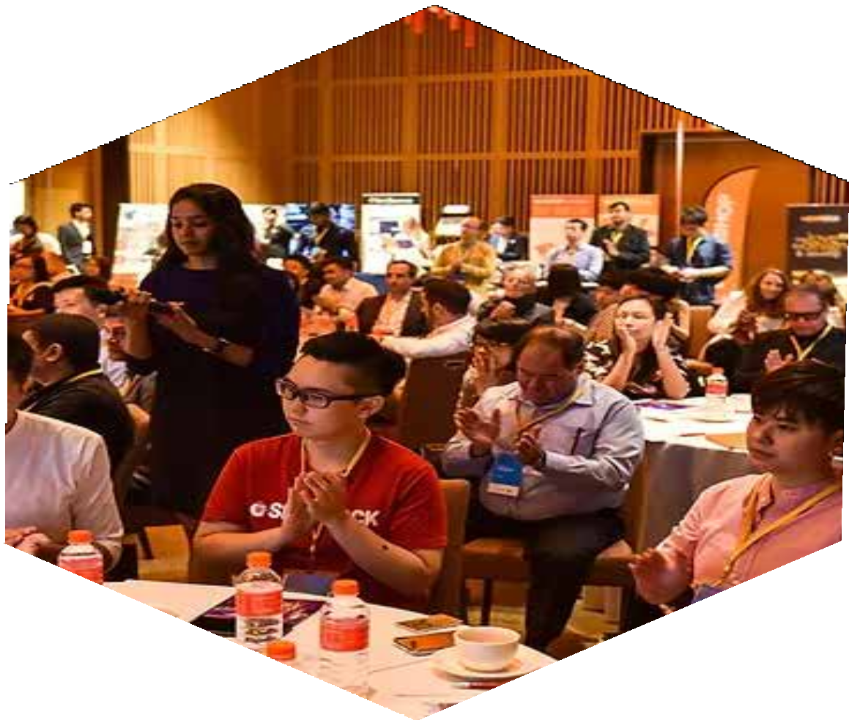
From discussions on social media marketing to search engine optimiza- tion and inﬂuencer strategies, these events offer valuable insights into the ever-changing digital marketing landscape. By attending such sum- mits, marketers can gain a competitive edge by implementing cut- ting-edge strategies that resonate with the target audience and drive business growth.
One of the key beneﬁts of attending the Kuala Lumpur Summit 2023 is the opportunity to network with industry experts. These events bring to- gether professionals from diverse backgrounds, including marketers, en- trepreneurs, thought leaders, and technology innovators. Engaging in conversations with these experts allows attendees to gain invaluable knowledge, seek advice, and build meaningful connections.By establish- ing relationships with industry leaders, marketers can leverage their ex- pertise and stay connected even after the summit, fostering collaboration and future growth opportunities.
https://www.salesgasm.com

Slide 5
FOLLOW US
https://www.facebook.com/salesgasm
https://www.linkedin.com/company/intrigue-summit
https://www.instagram.com/salesgasm/
https://twitter.com/salesgasm

Slide 6
CONTACT US
+61 3 9016 0770
www.salesgasm.com

Slide 7
THANK YOU
www.salesgasm.com

