Slide 1

TORONTO
SUMMIT 2023
https://www.salesgasm.com

Slide 2
ABOUT US
Dubbed by many as the company with an outlandish name that sticks to the mind for an eternity, Salesgasm is a professional sales and marketing training facilitation company. Its mission is to make sure that the world has better and more efﬁcient sales and marketing professionals and no company/department has to close down because it was not able to market and sell its products/services. Many of the ﬁnest sales and marketing professionals from across the globe are a part of the Salesgasm family.
https://www.salesgasm.com

Slide 3
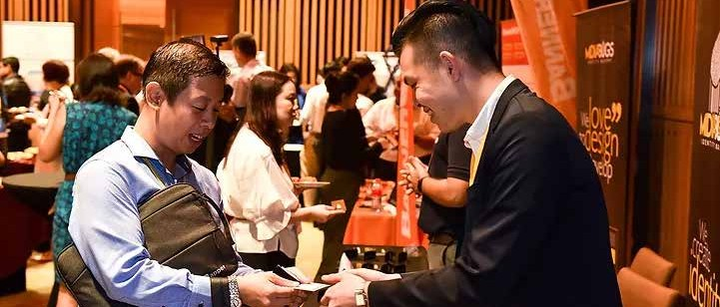
https://www.salesgasm.com
Exploring the Power of Toronto Summit 2023: Transforming the Future of Network- ing and Collabora- tion
In the innovative digital landscape, virtual events have become a prominent medium for con- necting professionals, sharing knowledge, and fostering meaningful collaborations. Among these virtual gatherings, Toronto Summit 2023 has emerged as a game-changer, revolutioniz- ing the way people network, learn, and grow. This blog takes you into the world of digital sum- mits, their benefits, and how they are transforming the future of networking and collaboration.

Slide 4
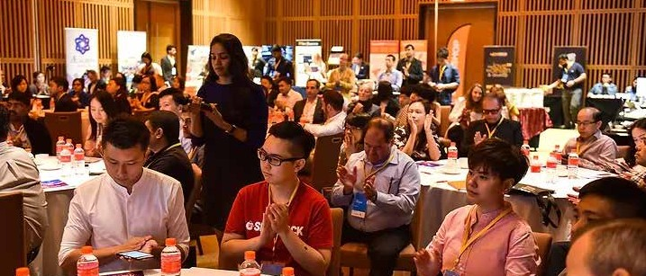
https://www.salesgasm.com
Understanding Dig- ital Summits: A New Era of Virtual Events
Digital summits generally are online conferences or gatherings that bring together industry ex- perts, thought leaders, and professionals from around the world. Unlike traditional physical con- ferences, these summits leverage digital platforms and advanced technologies to deliver im- mersive and interactive experiences. With features like live video streaming, virtual exhibition halls, and chat rooms, digital summits provide a comprehensive and engaging environment for attendees.

Slide 5
FOLLOW US
https://www.facebook.com/salesgasm
https://www.linkedin.com/company/intrigue-summit https://www.instagram.com/salesgasm/
https://twitter.com/salesgasm

Slide 6
CONTACT US
+61 3 9016 0770
www.salesgasm.com

Slide 7
THANK YOU
www.salesgasm.com

