Slide 1


BRAND
ACTIVATION
https://www.salesgasm.com/

Slide 2
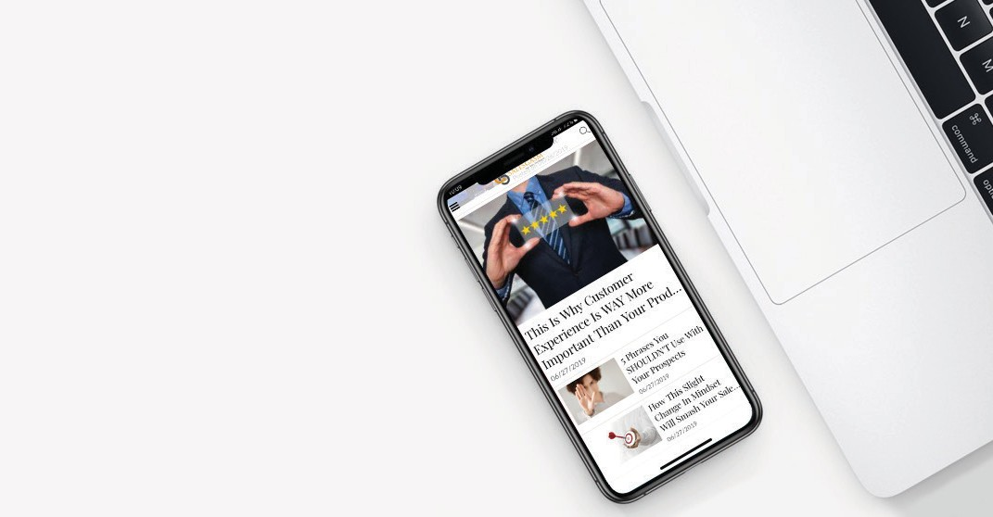

Dubbed by many as the company with an outlandish name that sticks to the mind for an eternity, Salesgasm is a professional sales and marketing training facilitation company. Its mission is to make sure that the world has better and more e cient sales and marketing professionals and no company/department has to close down because it was not able to market and sell its products/services. Many of the finest sales and marketing professionals from across the globe are a part of the Salesgasm family.
There are 2 ways Salesgasm provides education to sales and marketing professionals across the globe:
Salesgasm organizes world-class digital marketing conferences and sales conferences across the globe focused on Sales and Marketing attracting the best marketing and sales professionals and bringing them together under one roof to get educated, network and generate business.

Slide 3

Salesgasm provides training using the Salesgasm app which is a free Sales and Marketing training app on the play as well as the app store for organizations and individuals. The primary objective of the app is to provide free sales and marketing training to anyone from anywhere. It comes with the following features:
Free Sales Training
Free Marketing Training
Free Sales and Marketing Articles Free/Discounted Sales and Marketing Webinars Free Motivational Videos for Sales Professionals Free and Discounted Global Conference Tickets

Slide 4
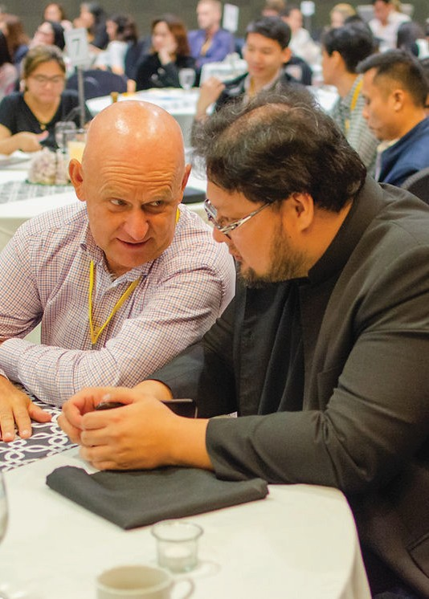

SALESGASM IS THE ONLY BRAND ACTIVATION AGENCY YOU NEED.
Salesgasm specialize in activating brands through creative and engaging experiences. Whether it’s an event, a social media campaign or a marketing stunt, we know how to get your target audience excited about your product or service.

Slide 5


Our brand activation team of experts will work with you to create a unique and memorable experience that leaves a lasting impression on your customers. We want you to be thrilled with the results – and we guarantee you will be. Contact us today to learn more about our services!

Slide 6
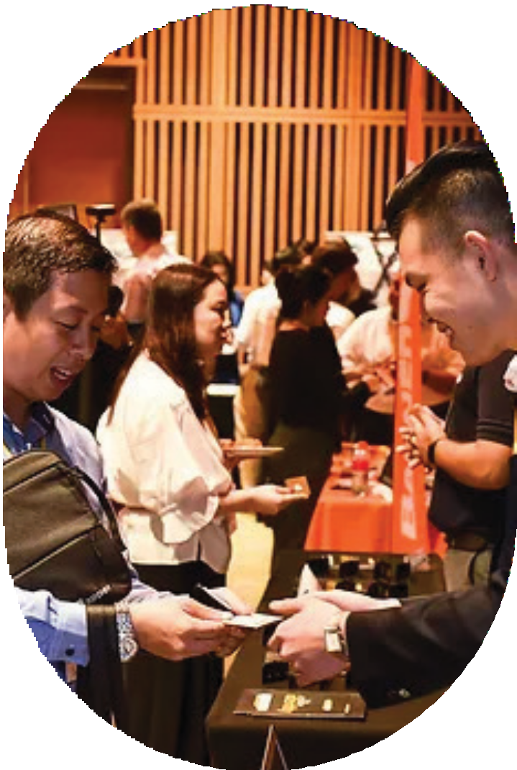
CONTACT US
Tel : +61 3 9016 0770
info@salesgasm.com
https://www.salesgasm.com/

Slide 7
https://www.salesgasm.com/

