Slide 1

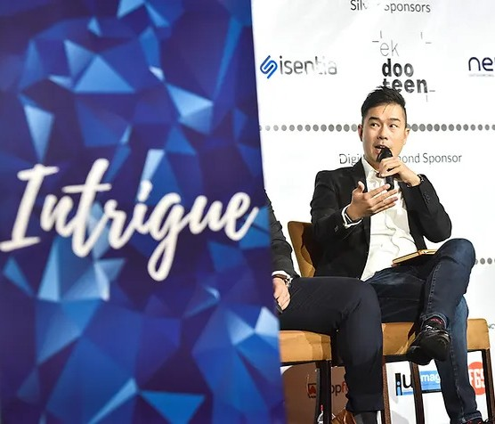
DUBLIN
DIGITAL MARKETING SUMMIT 2023
https://www.salesgasm.com

Slide 2
ABOUT US
Dubbed by many as the company with an outlandish name that sticks to the mind for an eternity, Salesgasm is a professional sales and marketing training facilitation company. Its mission is to make sure that the world has better and more efﬁcient sales and marketing professionals and no company/department has to close down because it was not able to market and sell its products/services. Many of the ﬁnest sales and marketing professionals from across the globe are a part of the Salesgasm family.
https://www.salesgasm.com

Slide 3

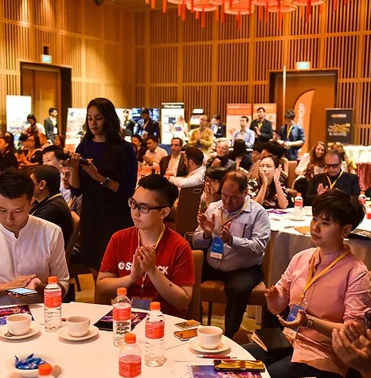

The digital landscape is rapidly evolving day by day and in this situ- ation, businesses must adapt to the demands of the digital age to stay competitive and drive success. The Digital Marketing Summit serves as a valuable platform for industry experts and professionals to gather, share insights, and discuss strategies that can propel businesses forward. It is important to know about the key learnings from the Dublin digital marketing summit 2023, highlighting how businesses can leverage digital marketing to drive success in the digital age.
HARNESSING THE POWER OF ANALYTICS
Successful businesses understand the importance of leveraging data analytics to drive decision making. The Digital Marketing Summit emphasized the need for businesses to invest in robust an- alytics tools and methodologies to gather actionable insights from customer data. By analyzing data on consumer behavior, prefer- ences, and engagement, businesses can refine their marketing strategies, personalize customer experiences, and optimize their campaigns for maximum impact.
IMPLEMENTING A/B TESTING
A key learning from the Digital Marketing Summit was the value of A/B testing. By conducting experiments and testing different varia- tions of marketing campaigns, businesses can determine what res- onates best with their target audience.

Slide 4

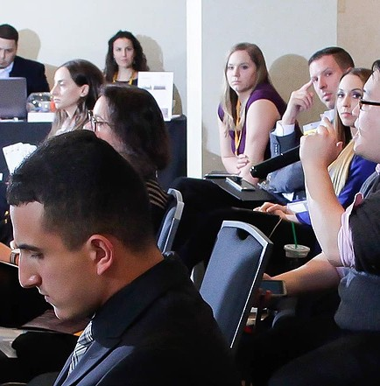

A/B testing allows businesses to fine-tune their messaging, design elements, and calls to action, leading to improved conversion rates and higher customer engagement.
UNDERSTANDING CUSTOMER SEGMENTATION
The Dublin digital marketing summit 2023 highlighted the signifi- cance of customer segmentation. By dividing their target audience into distinct groups based on demographics, behavior, or prefer- ences, businesses can deliver personalized experiences that reso- nate with each segment. Personalization enhances customer satis- faction, drives customer loyalty, and increases the likelihood of repeat purchases.
LEVERAGING MARKETING AUTOMATION
Marketing automation tools were a key focus at the Digital Market- ing Summit. These tools enable businesses to automate repetitive tasks, such as email campaigns and social media posts, while de- livering personalized messages to different segments of their audi- ence.
By leveraging marketing automation, businesses can save time, improve efficiency, and deliver tailored messages that nurture leads and drive conversions.
The Dublin digital marketing summit 2023 provides valuable in- sights into driving business success in the digital age.

Slide 5
FOLLOW US
https://www.facebook.com/salesgasm
https://www.linkedin.com/company/intrigue-summit https://www.instagram.com/salesgasm/ https://twitter.com/salesgasm

Slide 6
CONTACT US
+61 3 9016 0770
www.salesgasm.com

Slide 7
THANfi YOU
www.salesgasm.com

