Slide 1




Digital Marketing
Events
https://www.salesgasm.com/

Slide 2
Want a stage for
Marfieting Current Events?
Visit us at
Salesgasm!
https://www.salesgasm.com/

Slide 3
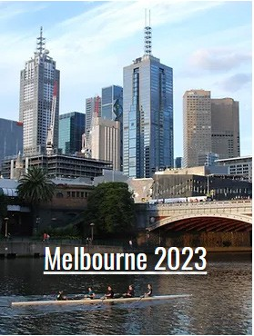
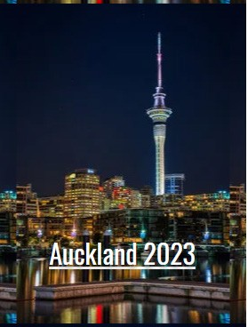
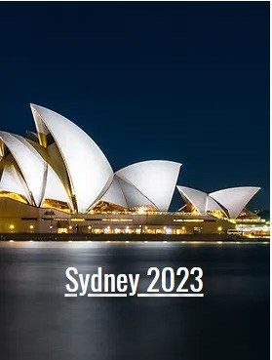
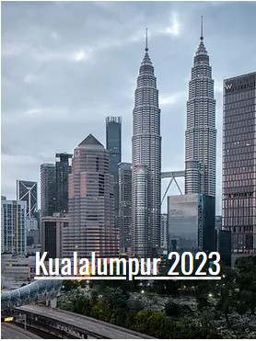
https://www.salesgasm.com/

Slide 4
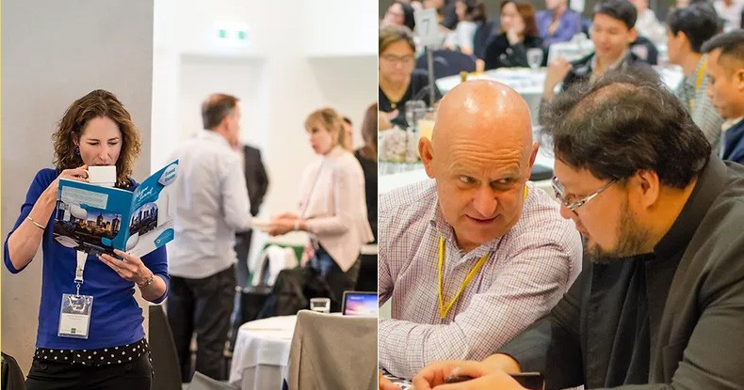
Intrigue Summit is a global Digital marketing conference and Exhibition focused on con- necting and Intrigue the best minds in marketing and tech under one roof.
https://www.salesgasm.com/

Slide 5

Intrigue Summits are orga- nized in New York, San Francis- co, Miami, Los Angeles, Mel- bourne, Sydney, Dubai, New Delhi, London, Singapore, Hong Kong and more...
https://www.salesgasm.com/

Slide 6
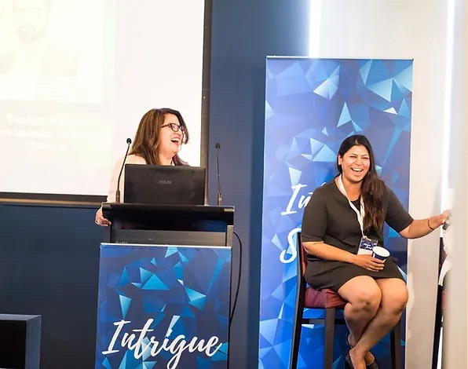
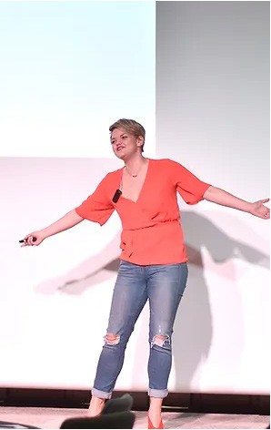
Intrigue Summits are about People. Q&A, De- bates and Discussions are an integral part of our events. It's the most intimate conference in the world.
https://www.salesgasm.com/

Slide 7


Install the salesgasm app to learn the latest techniques in marketing and sales. Installed in over 185 countries this app will empower you and your team to close deals the pro way.
The App will be available shortly
https://www.salesgasm.com/

Slide 8

- Follow us -
https://www.salesgasm.com/

Slide 9
Thank
YOU
https://www.salesgasm.com/

