Slide 1


DIGITAL MARKETING SEMINARS
https://www.salesgasm.com

Slide 2
ABOUT US
Dubbed by many as the company with an outlandish name that sticks to the mind for an eternity, Salesgasm is a professional sales and marketing training facilitation company. Its mission is to make sure that the world has better and more efﬁcient sales and marketing professionals and no company/department has to close down because it was not able to market and sell its products/services. Many of the ﬁnest sales and marketing professionals from across the globe are a part of the Salesgasm family.
https://www.salesgasm.com

Slide 3

Digital marketing has revolutionized the way businesses connect with their audiences. From social media campaigns to search engine optimization (SEO), the digital landscape offers unparalleled opportunities for growth and success. However, with the ever-evolving nature of the digital world, it's crucial for marketers and business owners to stay updated with the latest trends and strategies to stay ahead of the competition. That's where digital marketing seminars come into play.
These seminars are powerful tools for learning from industry experts who have immense experience in online marketing. These seminars provide valuable insights, practical tips, and actionable strategies that can help businesses optimize their digital marketing efforts and achieve tangible re- sults. Whether you're a seasoned marketer or a business owner looking to expand your online presence, these innovative marketing seminars can be a game-changer in your quest for success.
https://www.salesgasm.com

Slide 4
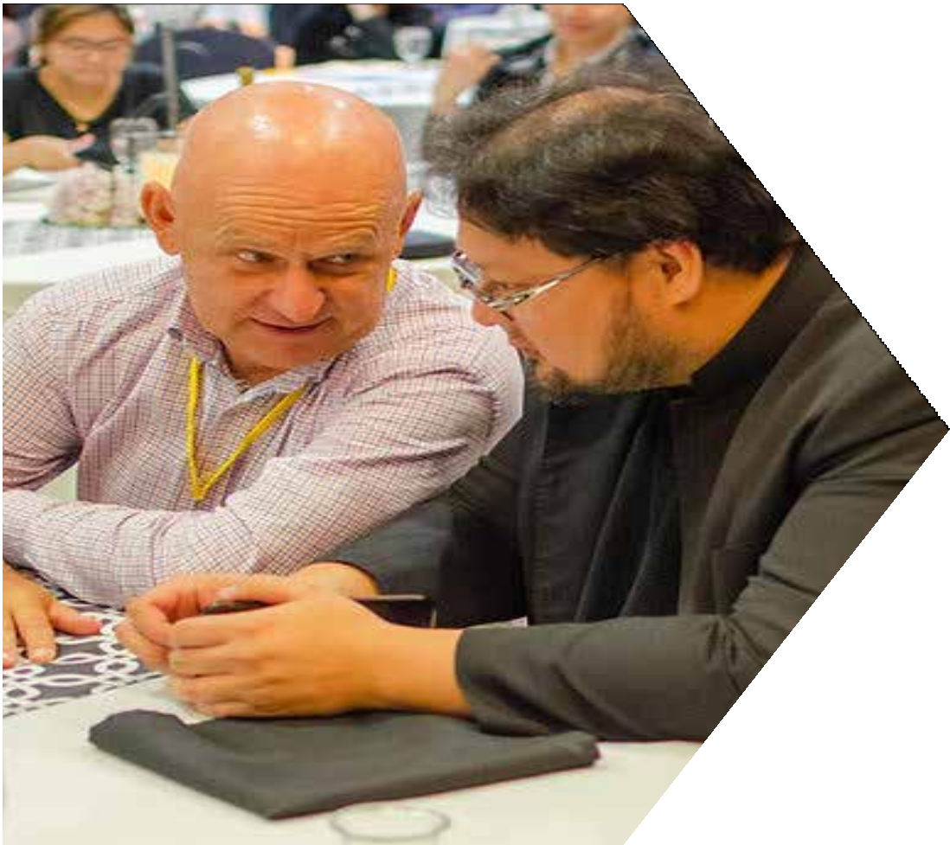
Attending these seminars can offer a variety of benefits that can help you unlock your marketing potential. Here remain some key advantages of at-
tending these seminars:
STAY AHEAD OF THE CURVE
The digital marketing landscape is constantly evolving, with new trends, techniques, and tools emerging regularly. Digital marketing seminars pro- vide you with the latest industry insights and best practices, helping you stay ahead of the curve and adapt your marketing strategies accordingly.
LEARN FROM INDUSTRY EXPERTS
These types of marketing seminars are typically led by industry experts who have a wealth of experience and expertise in the field.
https://www.salesgasm.com

Slide 5
FOLLOW US
https://www.facebook.com/salesgasm
https://www.linkedin.com/company/intrigue-summit https://www.instagram.com/salesgasm/ https://twitter.com/salesgasm

Slide 6
CONTACT US
+61 3 9016 0770
www.salesgasm.com

Slide 7
THANK YOU
www.salesgasm.com

