Slide 1
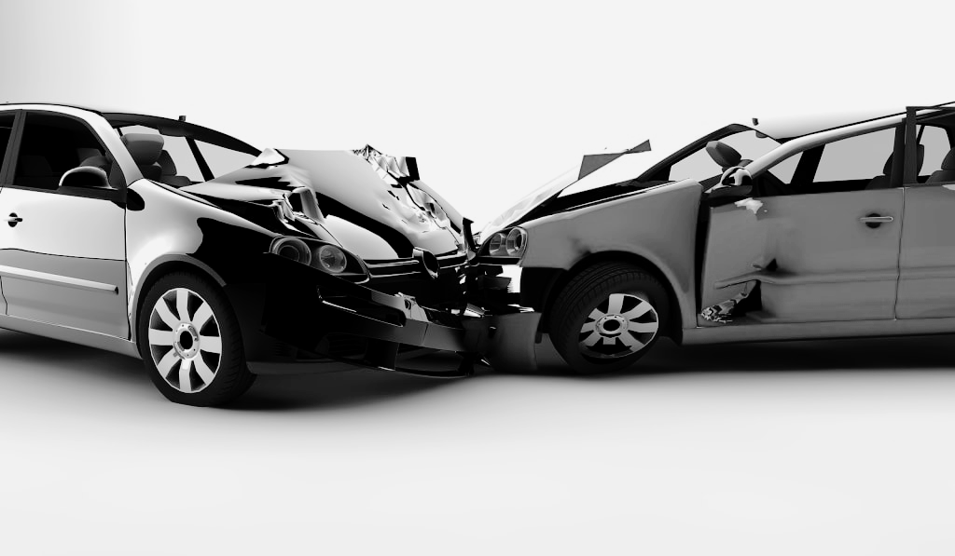
HOW TO HANDLE A HIT-AND-RUN CAR ACCIDENT?

Slide 2


INTRODUCTION
When the other motorist flees the scene after an accident, it can be even more painful. Being in a hit-and-run accident, which is illegal, might make you feel powerless, frustrated, and unsure of what to do next. This article describes the actions you should take to safeguard your rights and seek damages following a hit-and-run accident. We'll also concern about how an accident lawyer In Sparks may help you during this difficult time.

Slide 3
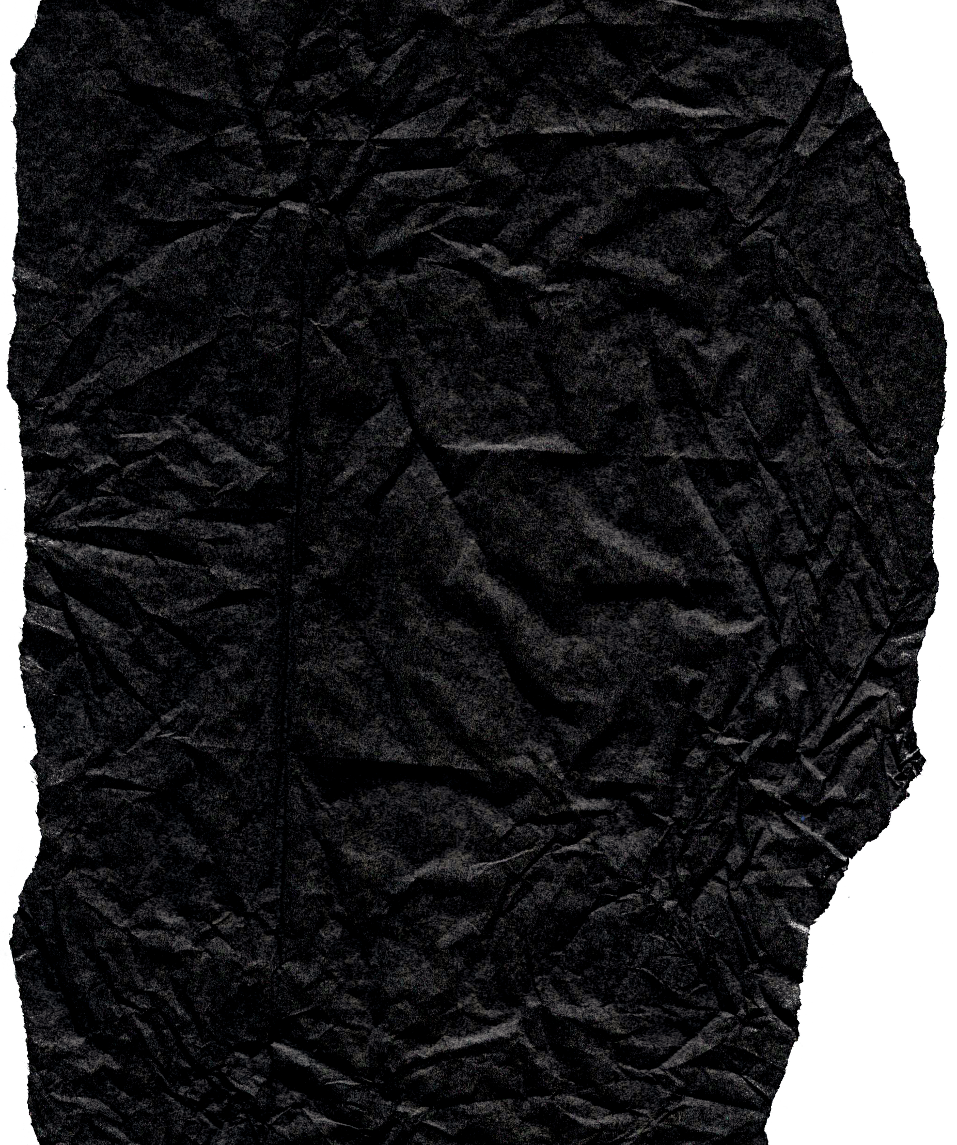

A CHECKLIST FOR AFTER A HIT-AND-RUN ACCIDENT

Slide 4

STAY CALM AND CALL FOR HELP:
The first thing you should do following a hit-and-run accident is to remain cool and ask for help.

Slide 5



SEEK MEDICAL ASSISTANCE:
Even if you don't feel wounded, receiving medical assistance after a hit-and-run accident is critical.

Slide 6


CONSULT WITH AN ACCIDENT ATTORNEY:
An expert personal injury lawyer in Carson City can walk you through the legal procedure and help you seek compensation for your losses.

Slide 7

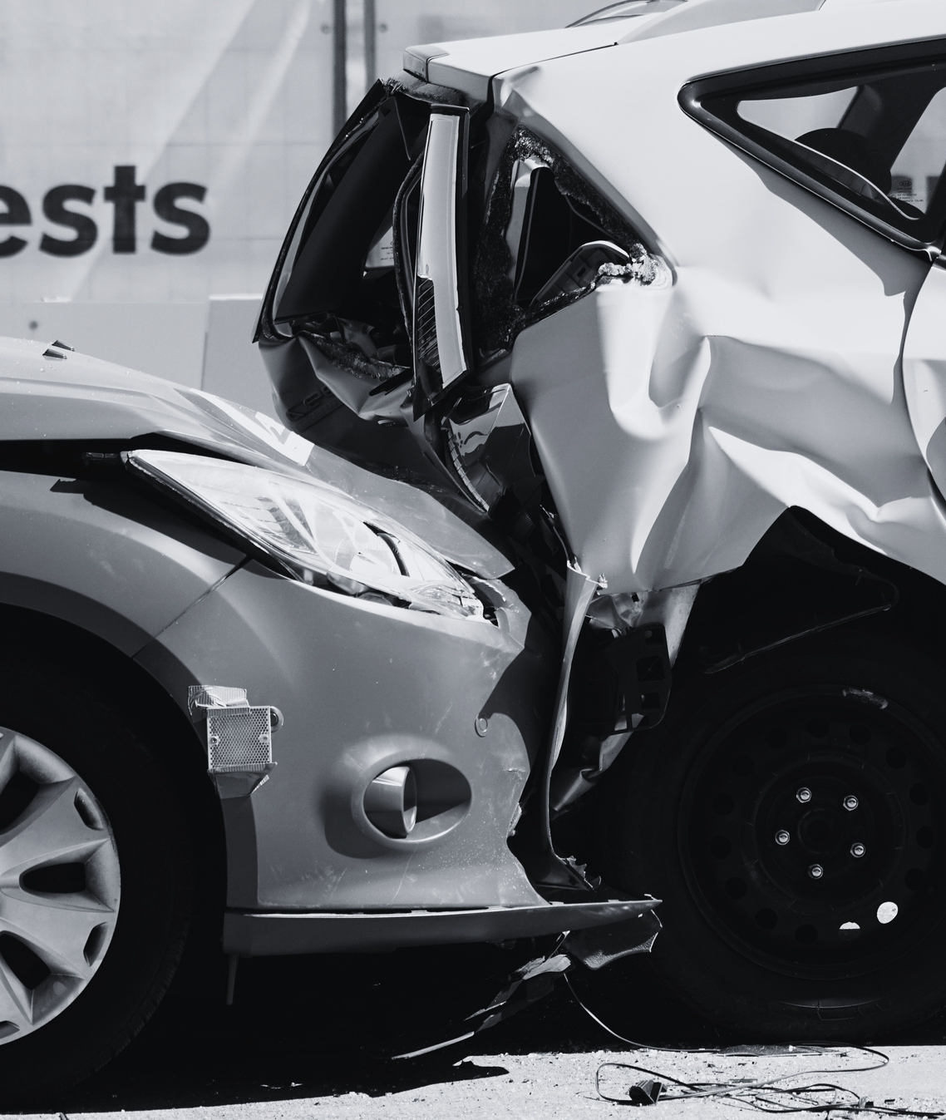
TELL YOUR INSURANCE COMPANY:
It's important to note that insurance companies are known for providing cheap settlements that don't properly repay you for your damages. As a result, having an accident attorney in Reno on your side is important.

Slide 8
THANKYOU
VISIT NOW
What to Do After a Hit-and-run Accident?

