Slide 1

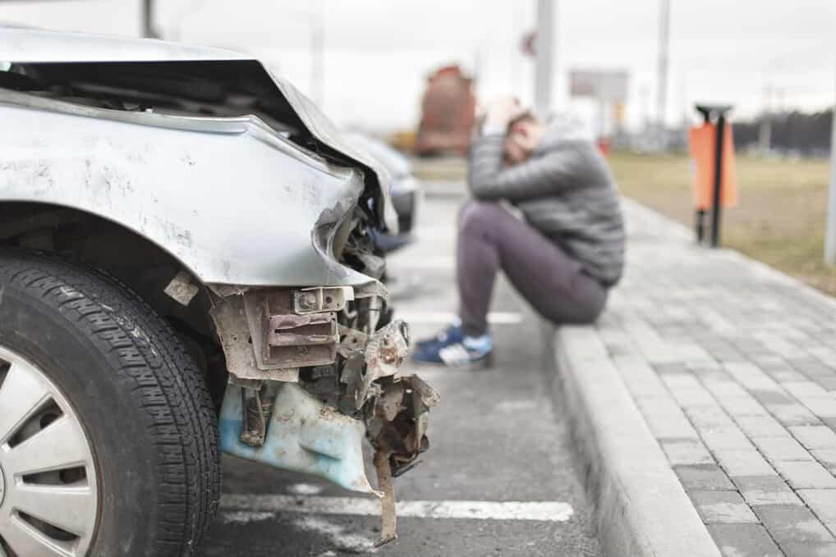

Tips to Recover Mentally After a Car Accident

Slide 2

Regaining mental health after a vehicle accident can be difficult. It is normal to feel things like fear, rage, and sadness. In this case, consulting a therapist, family member, or friend might be a helpful first step towards recovery. Following a car accident, self-care activities and attention to your physical well-being can aid in the recovery of your mental health.

Slide 3

Acknowledge Your Emotions
Seek Professional Help
Tips to Recover Mentally
Establish a Support System
Practice Self Care
Stay Informed About Your Legal Rights
Document Your Experience
Gradual Exposure

Slide 4


Acknowledge Your Emotions
It's intuitive to feel an influx of emotions following a car accident, including fear, anger, grief, and worry. Understanding and acknowledging these feelings is the initial stage toward your mental healing.

Slide 5

Seek Professional Help
If your mental grief becomes overbearing and persistent, consider seeking professional help. With the help of a mental health counselor or therapist, you can help control your emotions and crush trauma.

Slide 6

Establish a Support System
Developing an extensive support system can substantially enhance your mental health. Count on friends and family to seek emotional help and understanding.

Slide 7

Thankyou for Watching
Visit the Link Now
How to Recover Mentally from a Car Accident

