Slide 1
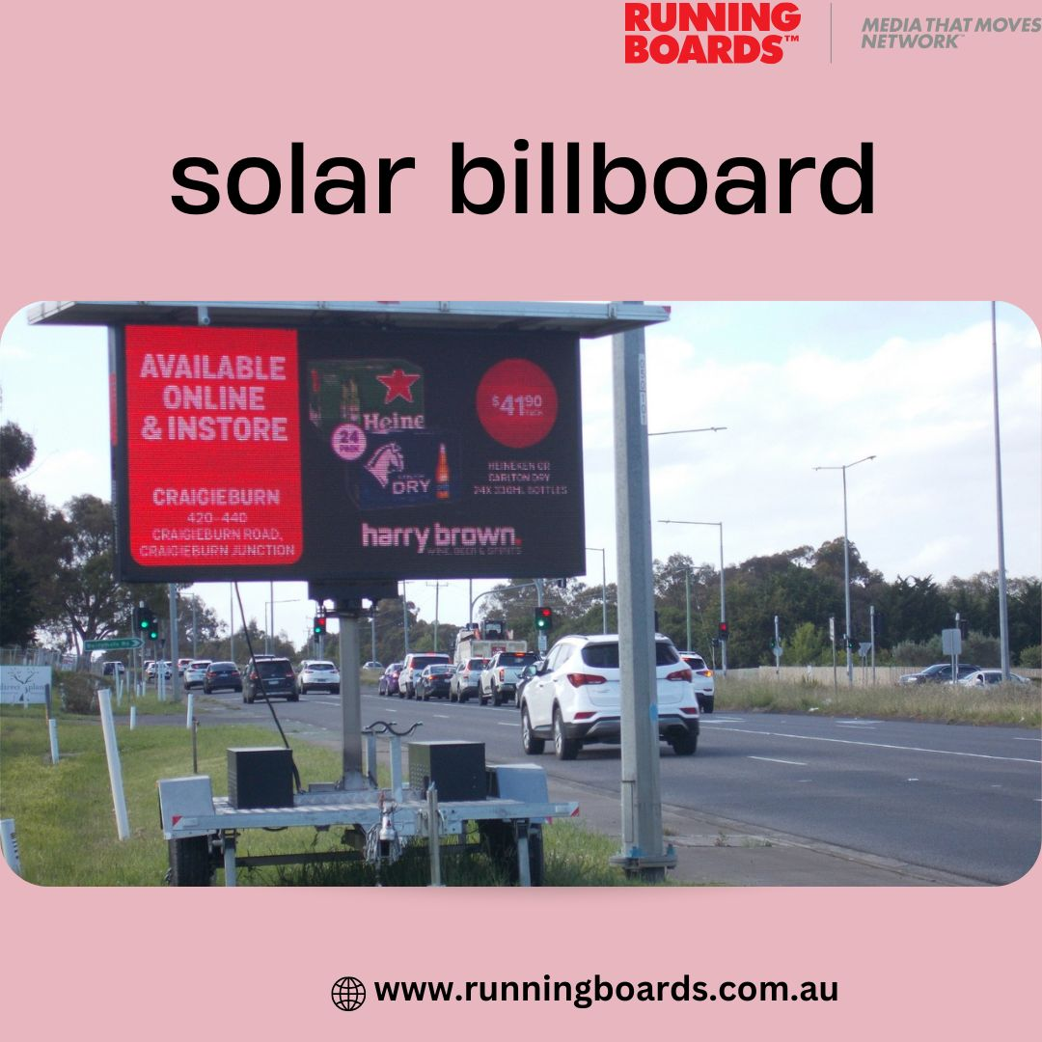
Solar Powered Billboards in Australia

Slide 2
Introduction
- Australia’s strong solar potential and demand for eco-friendly advertising.
- A solar powered billboard uses panels, batteries, and LED screens.
- Growing relevance as Australians value sustainability.

Slide 3
Why Solar Powered Billboards?
- Environmentally friendly: reduce CO₂ emissions.
- Off-grid capability: no power infrastructure needed.
- Continuous operation: works day and night with stored energy.

Slide 4
Key Features
- Solar panels and batteries: capture and store energy.
- LED display screens: bright, engaging visuals.
- Mobility: trailers can move where needed.
- Customisable content: quick message changes.

Slide 5
Benefits for Australian Advertisers
- Cost-effective: zero electricity bills.
- Eco-conscious branding: appeals to green consumers.
- High visibility: attention day and night.
- Versatile targeting: urban, events, or regional areas.

Slide 6
Real-World Examples
- Running Boards: 24/7 solar ad trailers across cities.
- Gold Coast Council: community safety messages.
- Brisbane Coorparoo Square: event promotions.
- NSW SharkWatch: coastal education campaigns.

Slide 7
Challenges & Considerations
- Higher upfront setup cost.
- Weather dependency: needs sunlight.
- Regulations: permits for bright screens.
- Maintenance: occasional cleaning required.

Slide 8
Future Outlook
- Australia leads in solar adoption (~34,631 MW by 2023).
- Rising demand for sustainable media.
- Ideal for smart cities, festivals, regional campaigns.
- Policy support and rebates make adoption easier.

Slide 9
Conclusion
- Solar powered billboard solutions are cost-saving, green, and effective.
- Provide high visibility and branding appeal.
- Set to become a mainstream choice for outdoor ads in Australia.

