Slide 1
8) Modelling in Mechanics
8.1) Constructing a model
8.2) Modelling assumptions
8.3) Quantities and units
8.4) Working with vectors

Slide 2
8.1) Constructing a model
Chapter CONTENTS

Slide 3
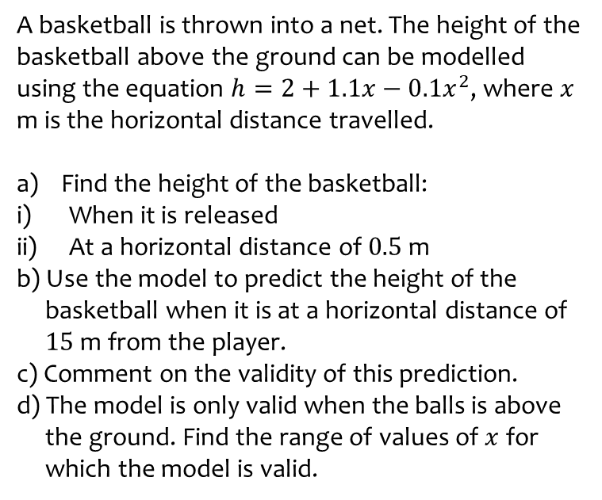
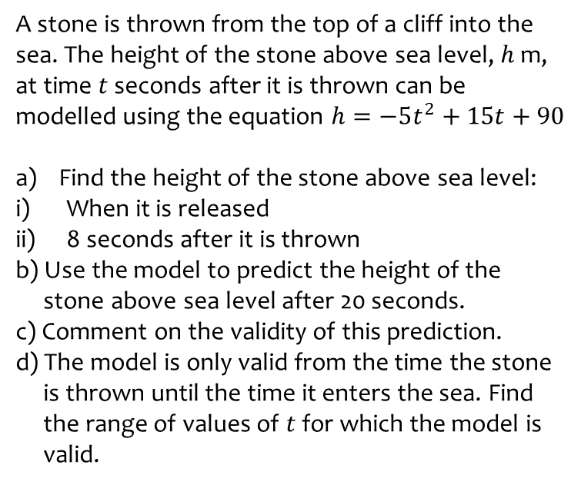
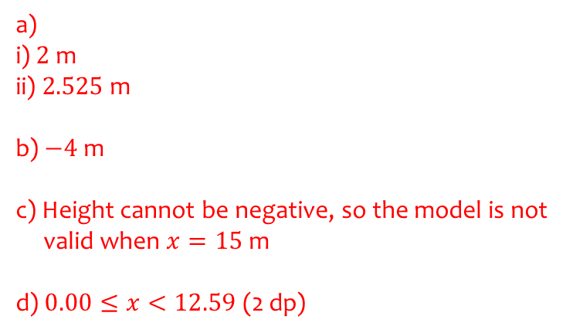
Worked example
Your turn
A stone is thrown from the top of a cliff into the sea. The height of the stone above sea level, $h$ m, at time $t$ seconds after it is thrown can be modelled using the equation $h=−5t^{2}+15t+90$
Find the height of the stone above sea level:
When it is released
8 seconds after it is thrown
b) Use the model to predict the height of the
stone above sea level after 20 seconds.
c) Comment on the validity of this prediction.
d) The model is only valid from the time the stone
is thrown until the time it enters the sea. Find
the range of values of $t$ for which the model is
valid.
A basketball is thrown into a net. The height of the basketball above the ground can be modelled using the equation $h=2+1.1x−0.1x^{2}$, where $x$ m is the horizontal distance travelled.
Find the height of the basketball:
When it is released
At a horizontal distance of $0.5$ m
b) Use the model to predict the height of the
basketball when it is at a horizontal distance of
$15$m from the player.
c) Comment on the validity of this prediction.
d) The model is only valid when the balls is above
the ground. Find the range of values of $x$ for
which the model is valid.
a)
i) $2$m
ii) $2.525$ m
b) $−4$m
c) Height cannot be negative, so the model is not
valid when $x=15$m
d) $0.00≤x<12.59$ (2 dp)

Slide 4
8.2) Modelling assumptions
Chapter CONTENTS

Slide 5
Worked example
Your turn
List assumptions you would make to create a simple model of:
The motion of two objects of different masses connected by a string that passes over a pulley
The motion of a child on a sledge going down a snow-covered hill
List assumptions you would make to create a simple model of:
The motion of a golf ball after it is hit
The motion of a suitcase on wheels being pulled along a path by its handle
Model the golf ball as a particle. Ignore the effects of air resistance. Ignore the rotational effect of any external forces acting on it.
Model the suitcase and handle as a single particle, consider the path to be smooth, and ignore friction between the wheels and their holdings.

Slide 6
8.3) Quantities and units
Chapter CONTENTS

Slide 7



Worked example
Your turn
Convert to SI units:
$56 km h^{−1}$
$51 g cm^{−2}$
$40 cm$ per minute
$42 g m^{−3}$
$5.4 ×{10}^{−3}$ $g cm^{−3}$
$3.6 ×{10}^{−2}$ $kg cm^{−2}$
Convert to SI units:
$65 km h^{−1}$
$15 g cm^{−2}$
$30 cm$ per minute
$24 g m^{−3}$
$4.5 ×{10}^{−2}$ $g cm^{−3}$
$6.3 ×{10}^{−3}$ $kg cm^{−2}$
$18.1 ms^{−1}$ (3 sf)
$$150 kg m^{−2}$$
$$5×{10}^{−3} ms^{−1}$$
$2.4×{10}^{−2}$ $kg m^{−3}$
$$45 kg m^{−3}$$
$$63 kg m^{−2}$$

Slide 8
8.4) Working with vectors
Chapter CONTENTS

Slide 9
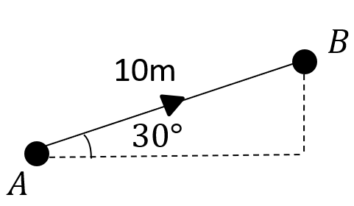
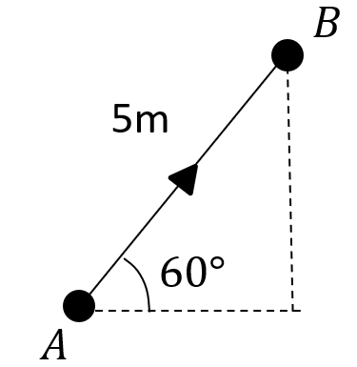

Worked example
Your turn
Convert from scalar to vector form:
Convert from scalar to vector form:
Displacement (from A) $=\left(\begin{matrix}5\cos{60°} \\ 5\sin{60°}\end{matrix}\right)=\left(\begin{matrix}2.5 \\ 4.33\end{matrix}\right) m$
Diagrams/Graphs used with permission from DrFrostMaths: https://www.drfrostmaths.com/

Slide 10
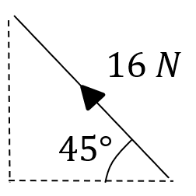
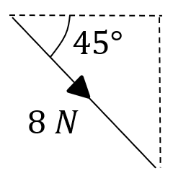
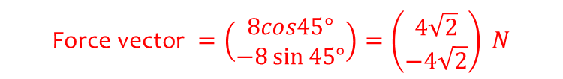
Worked example
Your turn
Convert from scalar to vector form:
Convert from scalar to vector form:
$$\text{Force} \text{vector} =\left(\begin{matrix}8cos45° \\ −8\sin{45°}\end{matrix}\right)=\left(\begin{matrix}4\sqrt{2} \\ −4\sqrt{2}\end{matrix}\right) N$$
Diagrams/Graphs used with permission from DrFrostMaths: https://www.drfrostmaths.com/

Slide 11

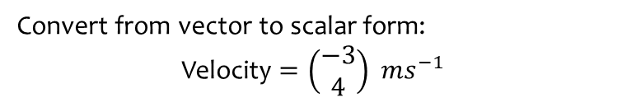
Worked example
Your turn
Convert from vector to scalar form:
Velocity $=\left(\begin{matrix}−3 \\ 4\end{matrix}\right) ms^{−1}$
Convert from vector to scalar form:
Velocity $=\left(\begin{matrix}5 \\ −12\end{matrix}\right) ms^{−1}$
Speed $=13 ms^{−1}$

Slide 12


Worked example
Your turn
Convert from vector to scalar form:
Acceleration $=\left(3i−4j\right) ms^{−2}$
Convert from vector to scalar form:
Acceleration $=\left(−6i+8j\right) ms^{−2}$
Magnitude of the acceleration $=10 ms^{−1}$

Slide 13
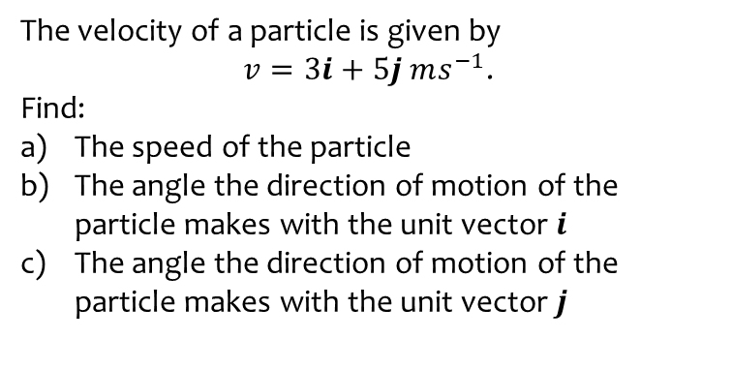
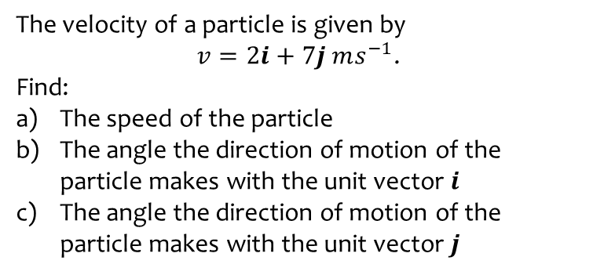
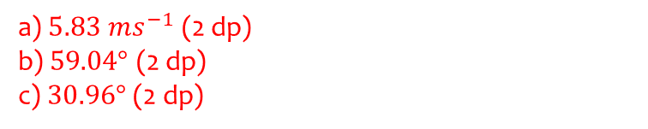
Worked example
Your turn
The velocity of a particle is given by
$v=2i+7j ms^{−1}$.
Find:
The speed of the particle
The angle the direction of motion of the particle makes with the unit vector $i$
The angle the direction of motion of the particle makes with the unit vector $j$
The velocity of a particle is given by
$v=3i+5j ms^{−1}$.
Find:
The speed of the particle
The angle the direction of motion of the particle makes with the unit vector $i$
The angle the direction of motion of the particle makes with the unit vector $j$
a) $5.83 ms^{−1}$ (2 dp)
b) $59.04°$ (2 dp)
c) $30.96°$ (2 dp)

Slide 14
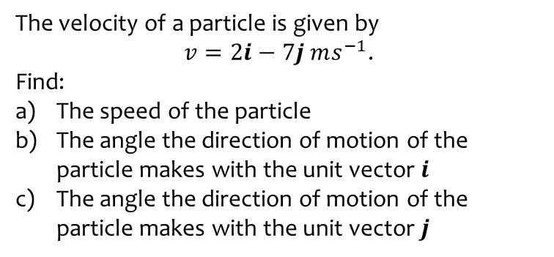
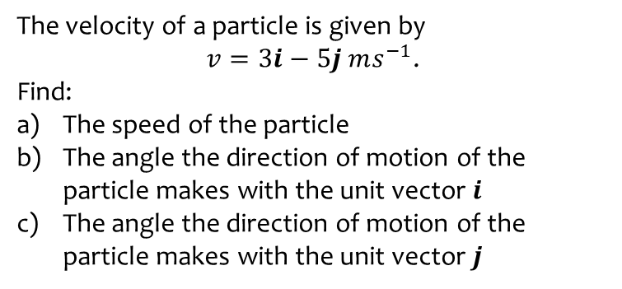
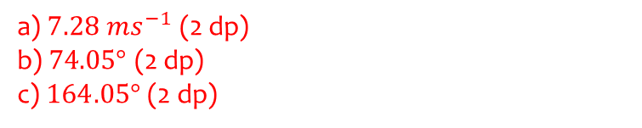
Worked example
Your turn
The velocity of a particle is given by
$v=3i−5j ms^{−1}$.
Find:
The speed of the particle
The angle the direction of motion of the particle makes with the unit vector $i$
The angle the direction of motion of the particle makes with the unit vector $j$
The velocity of a particle is given by
$v=2i−7j ms^{−1}$.
Find:
The speed of the particle
The angle the direction of motion of the particle makes with the unit vector $i$
The angle the direction of motion of the particle makes with the unit vector $j$
a) $7.28 ms^{−1}$ (2 dp)
b) $74.05°$ (2 dp)
c) $164.05°$ (2 dp)

Slide 15
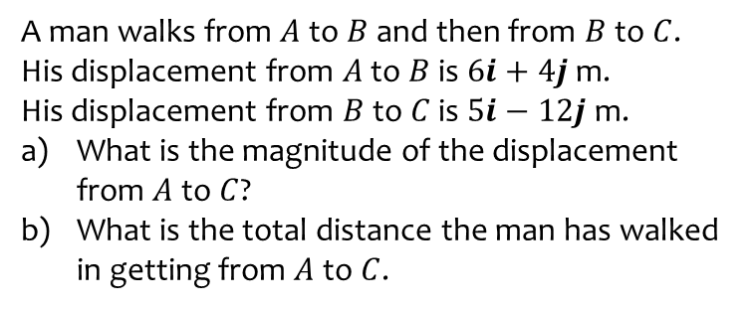
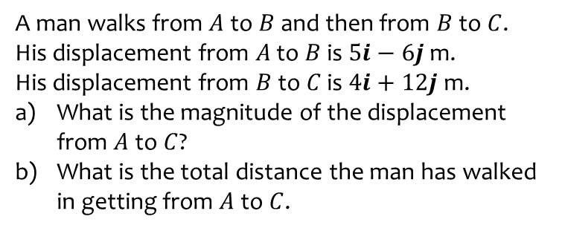
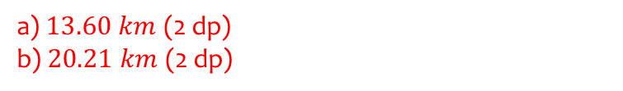
Worked example
Your turn
A man walks from $A$ to $B$ and then from $B$ to $C$.
His displacement from $A$ to $B$ is $5i−6j$ m.
His displacement from $B$ to $C$ is $4i+12j$ m.
What is the magnitude of the displacement from $A$ to $C$?
What is the total distance the man has walked in getting from $A$ to $C$.
A man walks from $A$ to $B$ and then from $B$ to $C$.
His displacement from $A$ to $B$ is $6i+4j$ m.
His displacement from $B$ to $C$ is $5i−12j$ m.
What is the magnitude of the displacement from $A$ to $C$?
What is the total distance the man has walked in getting from $A$ to $C$.
a) $13.60 km$ (2 dp)
b) $20.21 km$ (2 dp)

