Slide 1

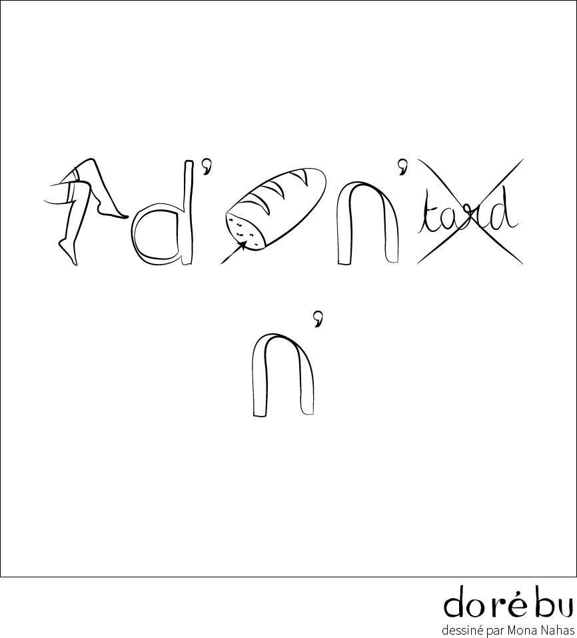


REBUS ①
SPORT
REBUS ②
SPORT
REBUS ③
SPORT
REBUS ④
SPORT

Slide 2


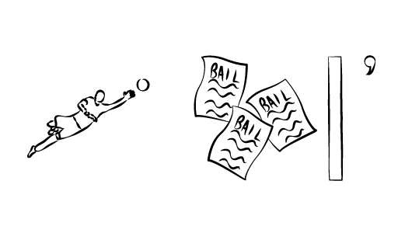
REBUS ⑤
PARASPORT
REBUS ⑥
PARASPORT
REBUS ⑦
PARASPORT
REBUS ⑧
PARASPORT

