Slide 1
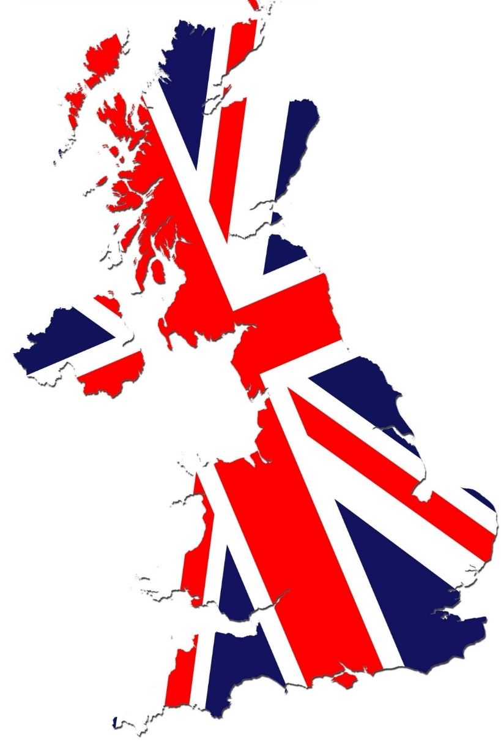
The United Kingdom
Symbols & Traditions

Slide 2
St. George’s flag
It’s the national flag of England

Slide 3
Royal Coat of Arms
A symbol that reflects the history of the Monarchy and the country. It’s a shield that is supported by a lion on the left and a unicorn on the right. On top of the shield one can see the Royal Crown, whereas the shield shows the various Royal emblems of different parts of the United Kingdom: the three lions of England in the first and fourth quarters, the lion of Scotland in the second and the harp of Ireland in the third.

Slide 4
The Rose
It’s the national flower of England.

Slide 5
The V-Sign
It’s the symbol of victory and peace

Slide 6
The Oak Tree
It’s the national tree of England and it symbolizes strength, longevity and endurance.

Slide 7
The Queen’s Guard
The man you see in front of Buckingham Palace is the Queen’s Guard. This name is given to the contingents of infantry and cavalry soldiers. As regards, his clothes the black bearskin cap is what attracts one’s attention.

Slide 8
Red London Buses
A big red bus is the best known symbol of London.

Slide 9
Black Cabs
London taxis are called black cabs. They look old-fashioned but they’re comfortable and speedy.

Slide 10
Telephone Boxes
Telephone kiosks, which have a picture of a crown, for public telephones are a familiar sight on the streets of the United Kingdom.

Slide 11
London Buskers
They’re street musicians.

Slide 12
Fish & chips
A classic English takeaway food; it’s the national food of England. The fish is fried and eaten with potato chips, whereas you can eat it using your fingers or small wooden forks.

Slide 13
A cup of tea
The afternoon tea is a tradition in England. It is a small meal which consists of tea, scones (small cakes), sandwiches and pastries.

Slide 14
The Championships, Wimbledon
The oldest tennis tournament in the world is held in Wimbledon, London since 1877.

Slide 15
Cricket
It’s the national sport of England, but it’s not as popular as football. It is played in the country from April to August. The players use a bat with which they hit a ball.

Slide 16
Punch & Judy
Punch and Judy are the characters of the traditional English puppet show featuring Punch and his wife Judy.

Slide 17
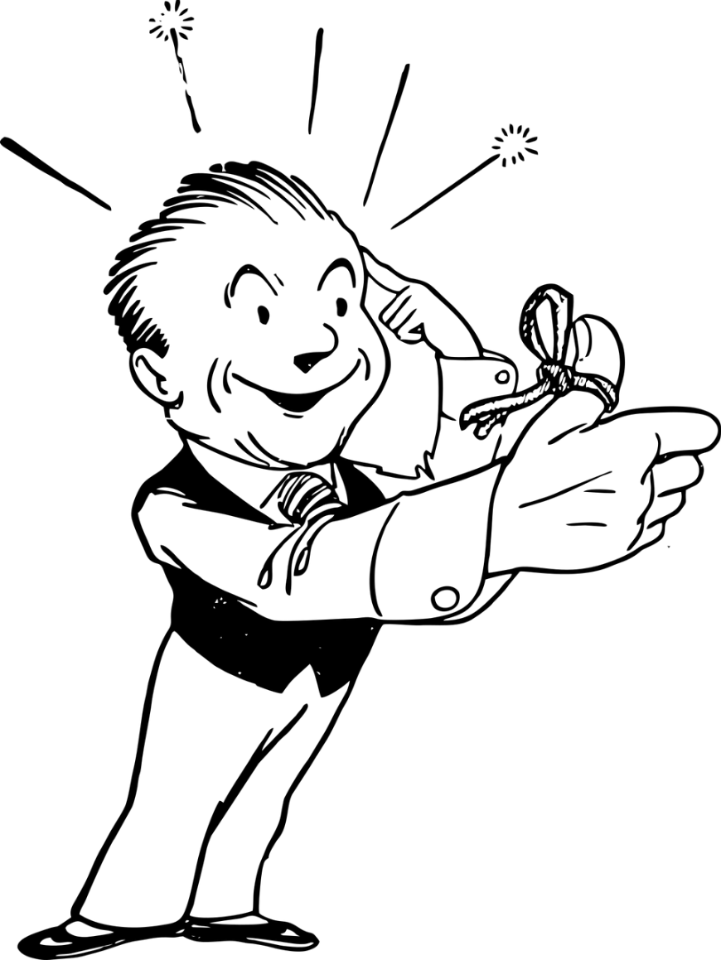
How about checking your memory?
Click here

Slide 18
Do you want to learn more?
Click at https://video.link/w/38qbc

Slide 19
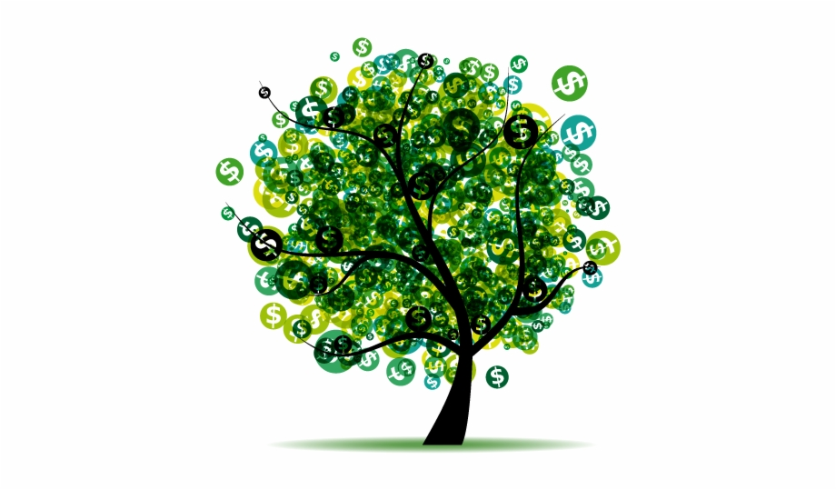
Let’s become millionaires
To play the game click here

